Slide 1

Pat and Steve Miller
May 18, 2023
ELECTRIFY EVERYTHING WITH INFLATION REDUCTION ACT (IRA)
Source: NASA
Notes:
J:\s\Documents\BE\2022-11-6-Trinity-Episcopal\2022-11-06-Moorestown-Slides.pptx
ID #3 - Can be used in noncommercial online and TV broadcasts of your presentation.
And then on the last of the Apollo missions, this image known as the Blue Marble, became the most reproduced photograph in all of human history. The climate crisis is now the biggest and most serious challenge that humanity has ever faced.
DESCRIPTION: Photo of Earth from Apollo 17, taken as the crew was traveling toward the moon, December 7, 1972
ADDITIONAL TALKING POINTS: This picture is called the “Blue Marble,” taken during the last Apollo mission.
What makes the photograph so unique and powerful is that it captures the complete circle of the earth, helping us see the big picture of our planet – and our lives on it.[1*] It was the first time the Apollo mission made it possible to capture almost the entire southern polar ice cap.[2*]
REFERENCES:
[1*] Ben Cosgrove, “Home, Sweet Home: In Praise of Apollo 17’s ‘Blue Marble’,” Time, April 11, 2014. http://time.com/3879555/blue-marble-apollo-17-photo-of-earth-from-space/
[2*] NASA Visible Earth, “The Blue Marble from Apollo 17," December 7, 1972. http://visibleearth.nasa.gov/view.php?id=55418

Slide 2
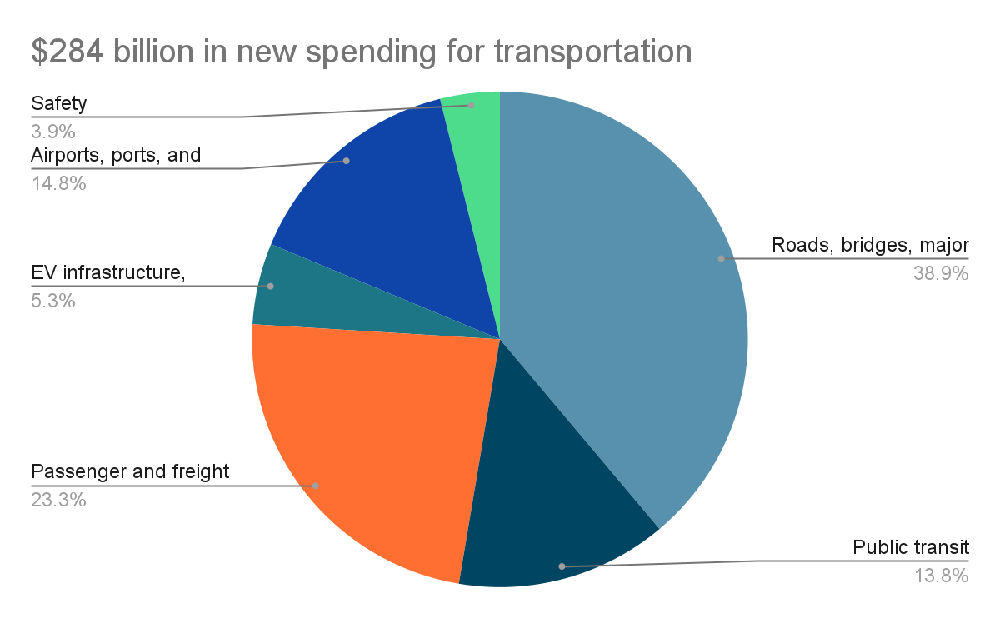
The Infrastructure Investment and Jobs Act (IIJA), sometimes called Bipartisan Infrastructure Law, is a five-year, $1.2 trillion infrastructure package that was signed into law in Nov 2021
$550 Billion In New Spending Over 5 Years!

Slide 3
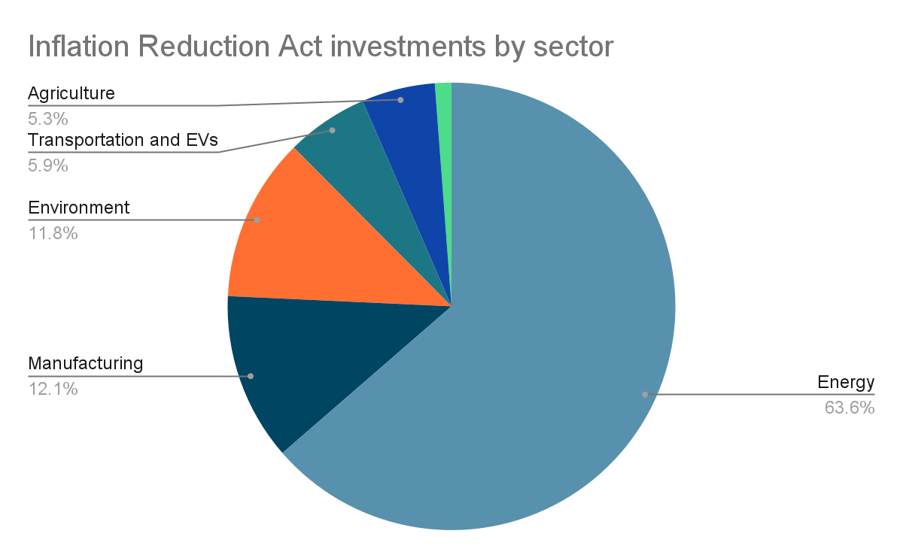
The Inflation Reduction Act (IRA) is a 9-year spending bill, that directs nearly $400 billion in federal funding to clean energy and conservation efforts, that was signed into law August 2022

Slide 4
Funding Streams of IIJA and IRA
IIJA and IRA have over 400 funding streams. Will flow to state and local governments in different ways.
Formula Grants (Set amount per State/Big City, Need to submit applications)
Block Grants (Set amount per State/Big City, Need to submit applications)
Competitive Grants (Awardees chosen among a pool of applicants via review process)
Loans (Pools of government funding that are expected to be paid back)
Direct Incentives (Tax Credits; Point of Sale Rebates)

Slide 5
Access to clean air & water, provide jobs, and address inequities
by winning racial justice-centered environmental victories that transform the current extractive and exploitative economy to one that is restorative and just for all
Justice40; ensuring President Biden’s Justice40 goal is realized- 40% of all investments in climate are given to disadvantaged communities
Transparency; to promote more awareness and transparency of what states and localities are applying for, processes need to be set up
(IRA) Environmental and Climate Justice Block Grant Program, $3 Billion in capacity building grants for "disadvantaged communities"
(IIJA) Emerging Contaminants/Lead Service Lines, $4 Billion/$15 Billion disbursed to states through the DWSRF.

Slide 6
Shift public/private dollars from fossil fuels
to restore clean air and water, provide affordable clean energy, support good paying jobs, and increase the ability of communities to be resilient to climate disruptions
(IRA) Electric Co-ops $9.7 billion; Loans and other financial assistance (including grants); purchase of renewable energy, renewable energy systems, zero-emission systems, and carbon capture and storage systems, to deploy such systems, or to make energy efficiency improvements to electric generation and transmission systems
(IRA) Greenhouse Gas Reduction Fund, $27 Billion; to be distributed by green banks and nonprofit lending institutions; $7 billion for low-income and community solar; $20 billion for general grant program

Slide 7
Replace fossil fuels with clean energy
We will continue to eliminate coal and gas in the power sector and achieve 80% carbon pollution-free electricity by 2030; we will end the sale of gas appliances by 2030 while ensuring that electrification of homes is the most affordable and accessible option for all families and communities.
(IRA) HOMES rebate program $8.8 Billion Dollars; formula grants for State Energy Offices provide rebates to homeowners and aggregators for whole-house electrification and energy efficiency retrofits
(IRA) Building Codes $1 Billion; competitive grants for states and localities adopt or implement building codes

Slide 8
Transform the Transportation Sector
60% of all new light-duty vehicles and 30% of all new heavy-duty vehicles will be electric, contributing to an 18% decrease in transportation sector oil use from 2019
(IIJA) Charging and Fueling Infrastructure Grants (Community Charging) $25 Billion; competitive grants to strategically deploy publicly accessible EV charging infrastructure along designated alternative fuel corridors. At least 50 percent of this funding must be used for a community grant program within rural areas, low-income neighborhoods, and communities with a low ratio of private parking spaces
(IIJA) Clean School Bus funding program $5 Billion; competitive rebates to replace existing school buses with zero-emission and low-emission models
(IIJA) Carbon Reduction Program $6 Billion; formula grants for funds for projects designed to reduce transportation emissions

Slide 9

Notes:
ID #7840 - This slide deck may be used in non-commercial presentations that are recorded, broadcast, livestreamed, or presented in-person. You may add your own personal slides to it, but users should make sure they have permission to include any third-party content in their personal slides. You may also remove slides to reduce the length. This slide deck may not be re-published without permission from Climate Reality, used for commercial purposes, or used to support or oppose candidates (or groups of candidates) for elected office. Finally, this slide deck may not be used to claim that The Climate Reality Project endorses any particular legislative action.
This is Our Climate Moment: From Acts to Action. What I'm going to present to you now is a shorter slideshow, just 15-20 minutes, but this one is packed with facts and figures about these laws, and specifically how to best take advantage of them and match them with some local and state measures in many locations as well.
DESCRIPTION: The Climate Reality Project and Our Climate Moment: From Acts to Action logos

Slide 10

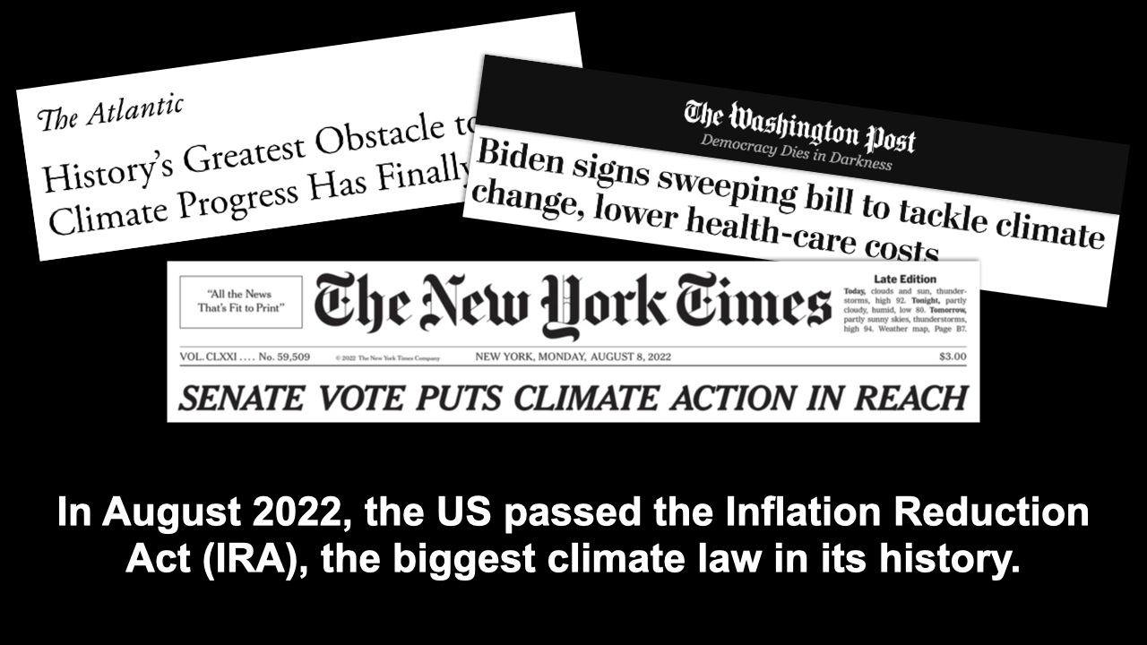
Notes:
ID #7752 - This slide deck may be used in non-commercial presentations that are recorded, broadcast, livestreamed, or presented in-person. You may add your own personal slides to it, but users should make sure they have permission to include any third-party content in their personal slides. You may also remove slides to reduce the length. This slide deck may not be re-published without permission from Climate Reality, used for commercial purposes, or used to support or oppose candidates (or groups of candidates) for elected office. Finally, this slide deck may not be used to claim that The Climate Reality Project endorses any particular legislative action.
As the news media has made clear, it's the biggest and best climate law ever passed by any country in all of history.
DESCRIPTION: Headlines from The Washington Post, The Atlantic, and The New York Times about the IRA, with text stating that in August 2022, the US passed the Inflation Reduction Act (IRA), the biggest climate law in its history
SLIDE SOURCE(S): https://www.nytimes.com/2022/08/07/us/politics/climate-tax-bill-passes-senate.html; https://www.theatlantic.com/science/archive/2022/08/senate-climate-inflation-reduction-bill-passed/671073/; https://www.washingtonpost.com/politics/2022/08/16/biden-inflation-reduction-act-signing/

Slide 11
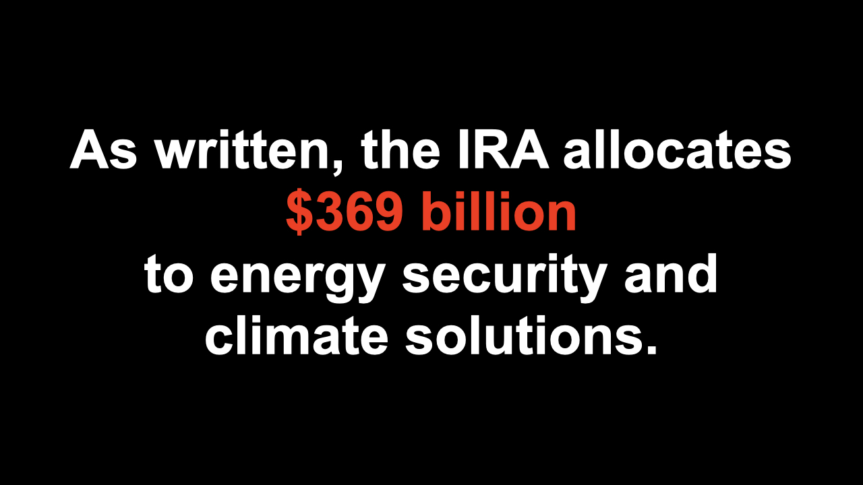
Notes:
ID #7753 - This slide deck may be used in non-commercial presentations that are recorded, broadcast, livestreamed, or presented in-person. You may add your own personal slides to it, but users should make sure they have permission to include any third-party content in their personal slides. You may also remove slides to reduce the length. This slide deck may not be re-published without permission from Climate Reality, used for commercial purposes, or used to support or oppose candidates (or groups of candidates) for elected office. Finally, this slide deck may not be used to claim that The Climate Reality Project endorses any particular legislative action.
This Act allocates almost $370 billion, according to the official estimate, to climate solutions and energy security, but it comes largely in the form of tax credits that don't have a limit on how many of them can be activated. So there are many experts who believe that it's going to be much larger than that.
DESCRIPTION: Text stating that as written, the IRA allocates $369 billion to energy security and climate solutions
SLIDE SOURCE(S): https://www.whitehouse.gov/wp-content/uploads/2022/12/Inflation-Reduction-Act-Guidebook.pdf; https://www.democrats.senate.gov/imo/media/doc/inflation_reduction_act_one_page_summary.pdf

Slide 12
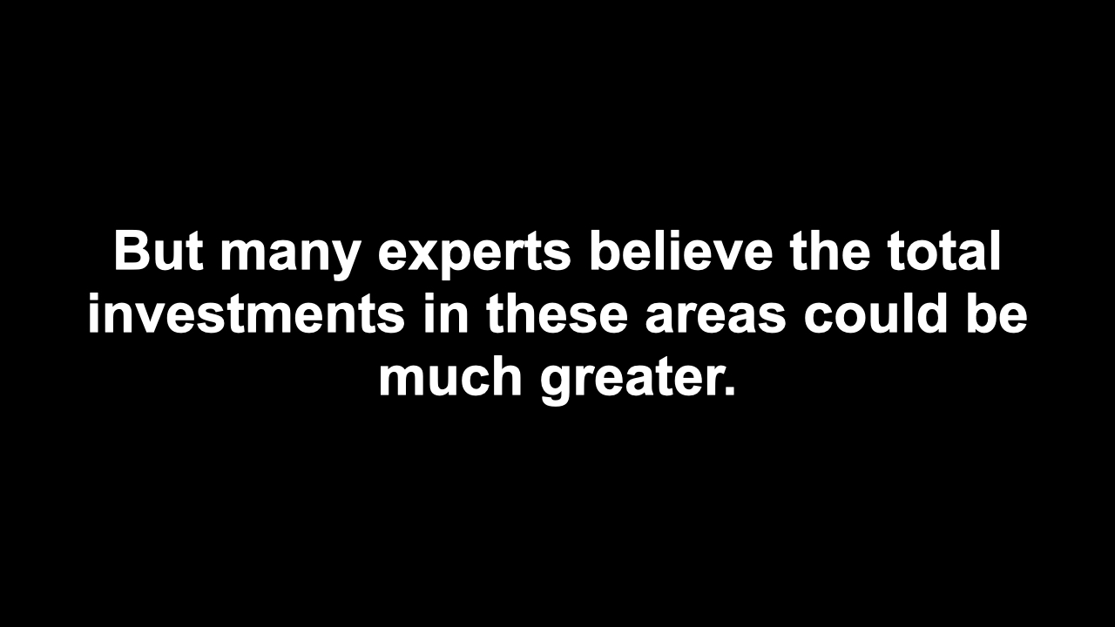
Notes:
ID #7758 - This slide deck may be used in non-commercial presentations that are recorded, broadcast, livestreamed, or presented in-person. You may add your own personal slides to it, but users should make sure they have permission to include any third-party content in their personal slides. You may also remove slides to reduce the length. This slide deck may not be re-published without permission from Climate Reality, used for commercial purposes, or used to support or oppose candidates (or groups of candidates) for elected office. Finally, this slide deck may not be used to claim that The Climate Reality Project endorses any particular legislative action.
A lot of them think it could be twice as big, maybe even three times as big. That's what Goldman Sachs said just last week. That's good news as far as I'm concerned.
DESCRIPTION: Text stating: but many experts believe the total investments in these areas could be much greater
ADDITIONAL TALKING POINTS: This is because the enthusiasm for using the tax credits and other elements of the law is much higher than anticipated.
SLIDE SOURCE(S): https://www.bloomberg.com/news/articles/2022-11-03/the-us-climate-bill-is-a-bigger-deal-than-most-people-realize?sref=4dbYjOo8; https://www.theatlantic.com/science/archive/2022/10/inflation-reduction-act-climate-economy/671659/

Slide 13
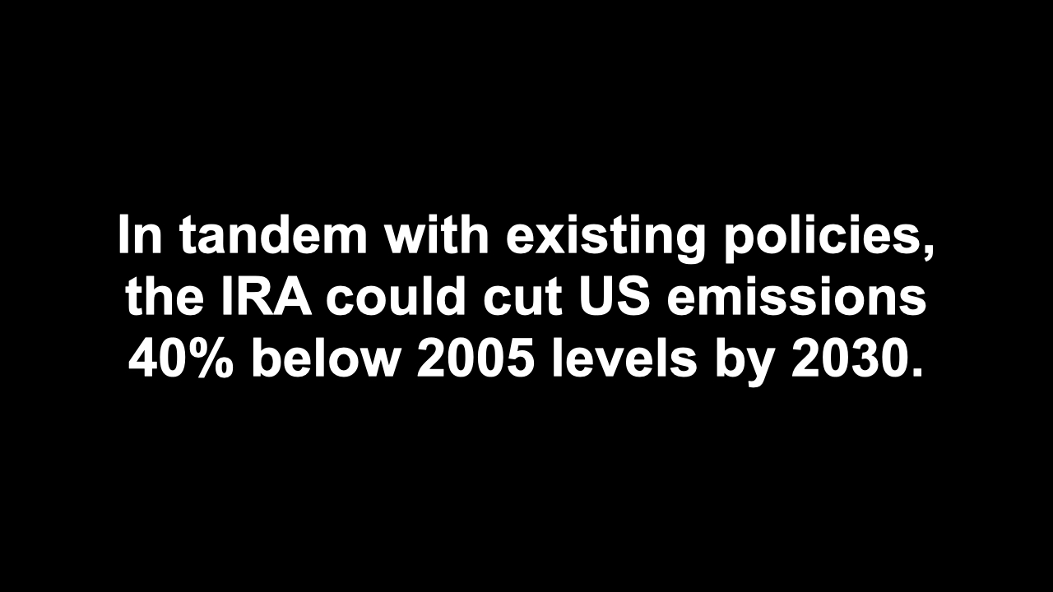
Notes:
ID #7759 - This slide deck may be used in non-commercial presentations that are recorded, broadcast, livestreamed, or presented in-person. You may add your own personal slides to it, but users should make sure they have permission to include any third-party content in their personal slides. You may also remove slides to reduce the length. This slide deck may not be re-published without permission from Climate Reality, used for commercial purposes, or used to support or oppose candidates (or groups of candidates) for elected office. Finally, this slide deck may not be used to claim that The Climate Reality Project endorses any particular legislative action.
This law, when combined with existing policy, will enable the US to sharply reduce global warming pollution by 40% or so below the 2005 levels. That's getting close to the commitments we made as part of the Paris Agreement.
DESCRIPTION: Text stating that in tandem with existing policies, the IRA could cut US emissions 40% below 2005 levels by 2030
SLIDE SOURCE(S): https://rhg.com/research/climate-clean-energy-inflation-reduction-act/

Slide 14
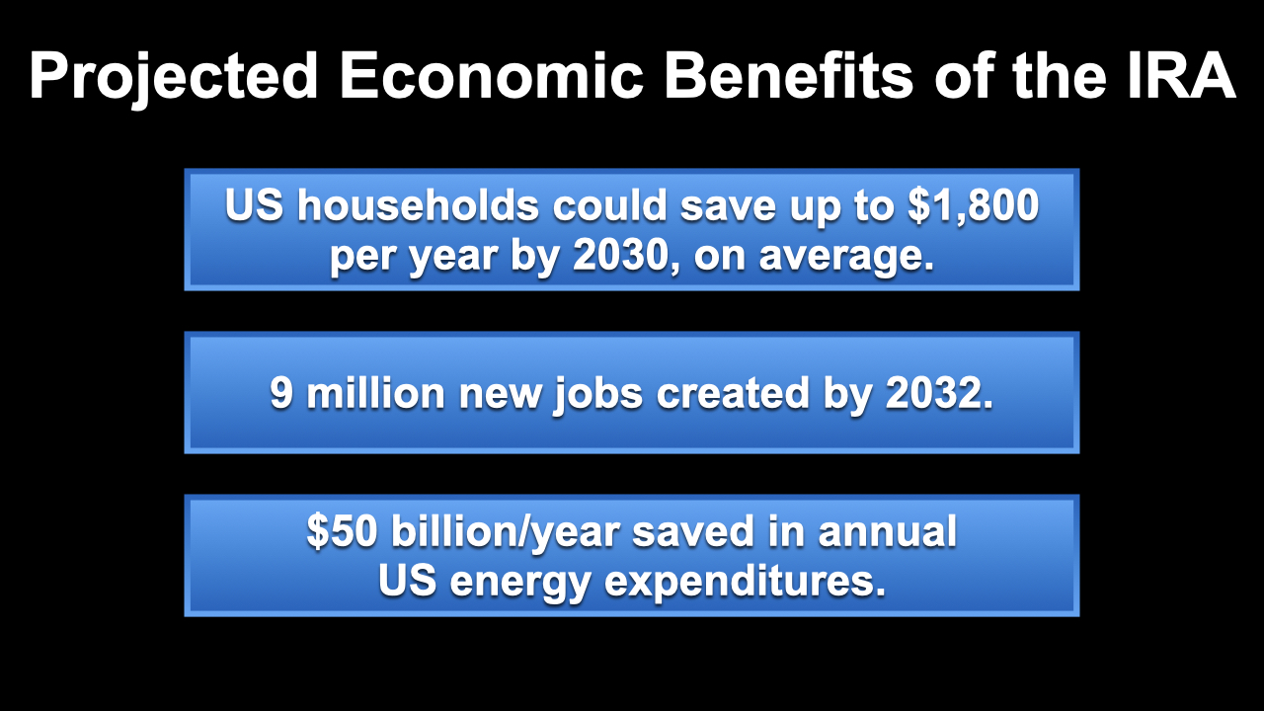
Notes:
ID #7762 - This slide deck may be used in non-commercial presentations that are recorded, broadcast, livestreamed, or presented in-person. You may add your own personal slides to it, but users should make sure they have permission to include any third-party content in their personal slides. You may also remove slides to reduce the length. This slide deck may not be re-published without permission from Climate Reality, used for commercial purposes, or used to support or oppose candidates (or groups of candidates) for elected office. Finally, this slide deck may not be used to claim that The Climate Reality Project endorses any particular legislative action.
It also has incredible economic benefits. It saves money for American households, up to $1,800 per year on average. That's real money that a lot of families will really appreciate and need. It creates more than 9 million good, new jobs, and that's incredible. We've seen for a long time now how the investments in clean energy and emissions reductions create many more jobs than continuing to throw money into the dirty, poisonous, polluting fossil fuel economy. It also reduces energy bills and energy expenditures for the entire country at least by 4% – that's really terrific as well.
DESCRIPTION: Text listing the projected economic benefits of the IRA: US households could save up to $1,800 per year by 2030, on average; 9 million new jobs created by 2032; and $50 billion/year saved in annual US energy expenditures
SLIDE SOURCE(S): https://www.rewiringamerica.org/policy/inflation-reduction-act; https://www.bluegreenalliance.org/site/9-million-good-jobs-from-climate-action-the-inflation-reduction-act/; https://repeatproject.org/docs/REPEAT_IRA_Prelminary_Report_2022-09-21.pdf

Slide 15
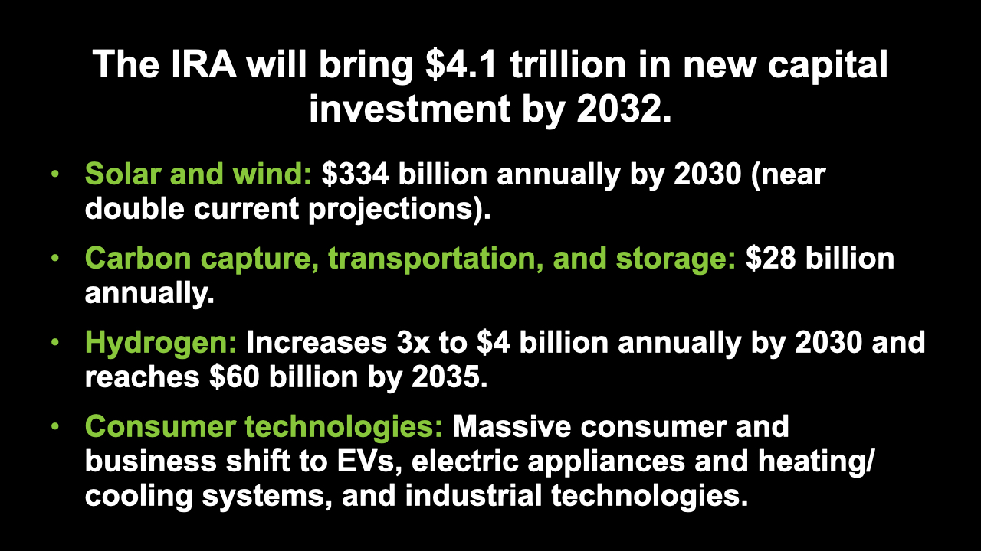
Notes:
ID #7763 - This slide deck may be used in non-commercial presentations that are recorded, broadcast, livestreamed, or presented in-person. You may add your own personal slides to it, but users should make sure they have permission to include any third-party content in their personal slides. You may also remove slides to reduce the length. This slide deck may not be re-published without permission from Climate Reality, used for commercial purposes, or used to support or oppose candidates (or groups of candidates) for elected office. Finally, this slide deck may not be used to claim that The Climate Reality Project endorses any particular legislative action.
It is expected to result in more than $4 trillion in new cumulative capital investment, because, remember, a lot of these provisions are triggered when the private sector, individuals, companies, cities, and states invest money in order to get the benefits of the IRA. We have already seen so many companies, some of them from overseas, moving their operations to the US because they can take advantage of these new incentives in the IRA. For example, solar and wind. This nearly doubles the current spending on solar and wind. That's really exciting for me. A lot is allocated to carbon capture, which some of us have mixed feelings about. I hope they find a breakthrough. Transportation, energy storage, $28 billion annually. That's great, I'm very excited about that as well. Now, it also will allow some of these companies to keep experimenting with what's called blue hydrogen and gray hydrogen. That's not good because it's made out of fossil fuels. But clean hydrogen, green hydrogen, is made with renewable energy and water; there's no pollution, and it substitutes for heavily polluting options. So there’s a big increase for hydrogen in this bill. And we'll talk more about heat pumps, and induction stoves, and more efficient appliances, and industrial technologies that are more efficient.
DESCRIPTION: Text stating that the IRA will bring $4.1 trillion in new capital investment by 2032. This includes: solar and wind: $334 billion annually by 2030 (near double current projections); carbon capture, transportation, and storage: $28 billion annually; hydrogen: increases 3x to $4 billion annually by 2030 and reaches $60 billion by 2035; and consumer technologies: massive consumer and business shift to EVs, electric appliances and heating/cooling systems, and industrial technologies.
SLIDE SOURCE(S): https://repeatproject.org/docs/REPEAT_IRA_Prelminary_Report_2022-09-21.pdf

Slide 16

Notes:
ID #7867 - This slide deck may be used in non-commercial presentations that are recorded, broadcast, livestreamed, or presented in-person. You may add your own personal slides to it, but users should make sure they have permission to include any third-party content in their personal slides. You may also remove slides to reduce the length. This slide deck may not be re-published without permission from Climate Reality, used for commercial purposes, or used to support or oppose candidates (or groups of candidates) for elected office. Finally, this slide deck may not be used to claim that The Climate Reality Project endorses any particular legislative action.
Because of people like you who weighed in and spoke up, you made a huge difference and enabled Congress to pass the IRA and make it law. Now it's time to make your voices heard with the local policymakers and the state policymakers, because this is the time for them to join in. It's beneficial for them, beneficial for all of us.
DESCRIPTION: Text stating that we’re here because people like you told the Biden Administration and Congress to act. It’s time for local and state policymakers to get the message.

Slide 17
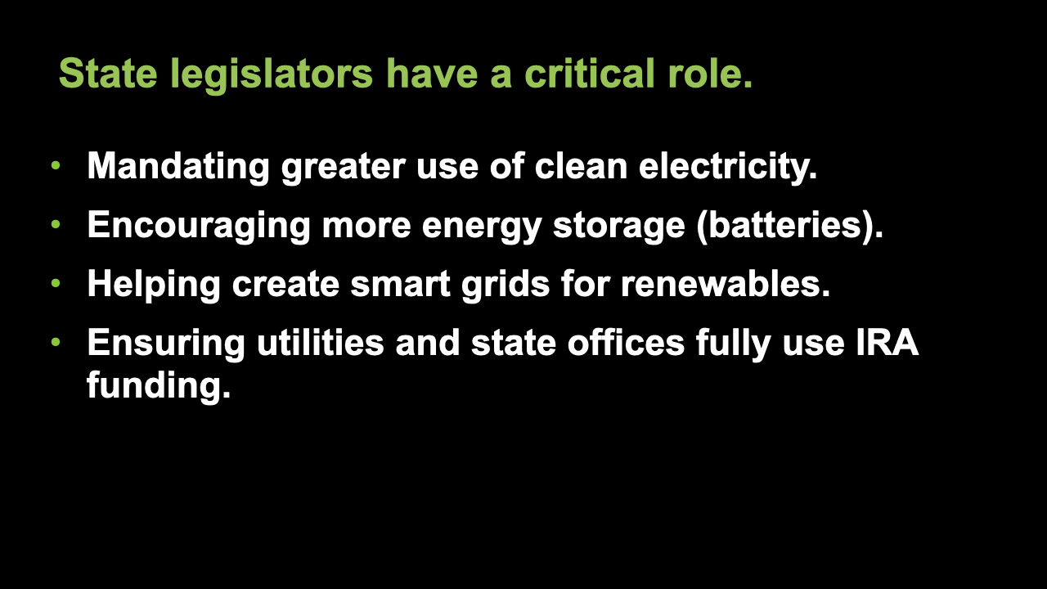
Notes:
ID #7844 - This slide deck may be used in non-commercial presentations that are recorded, broadcast, livestreamed, or presented in-person. You may add your own personal slides to it, but users should make sure they have permission to include any third-party content in their personal slides. You may also remove slides to reduce the length. This slide deck may not be re-published without permission from Climate Reality, used for commercial purposes, or used to support or oppose candidates (or groups of candidates) for elected office. Finally, this slide deck may not be used to claim that The Climate Reality Project endorses any particular legislative action.
State policymakers are crucial. Let's take the different categories. State legislators, for example, can mandate greater use of clean energy. That will pull more investment dollars into their states. They can encourage building more batteries for energy storage. That will position their state to be in the lead. They can help to create more smart grids on a state basis or a regional basis for the greater use of renewable energy. That's really one of the key tasks ahead of us. They can ensure that utilities and state offices make full use of the IRA funding for the energy transition.
DESCRIPTION: Text stating that state legislators have a critical role: mandating greater use of clean electricity; encouraging more energy storage (batteries); helping create smart grids for renewables; and ensuring utilities and state offices fully use IRA funding
SLIDE SOURCE(S): https://energyinnovation.org/wp-content/uploads/2022/11/Inflation-Reduction-Act-Electricity-State-Policy-Roadmap-One-Pager.pdf

Slide 18
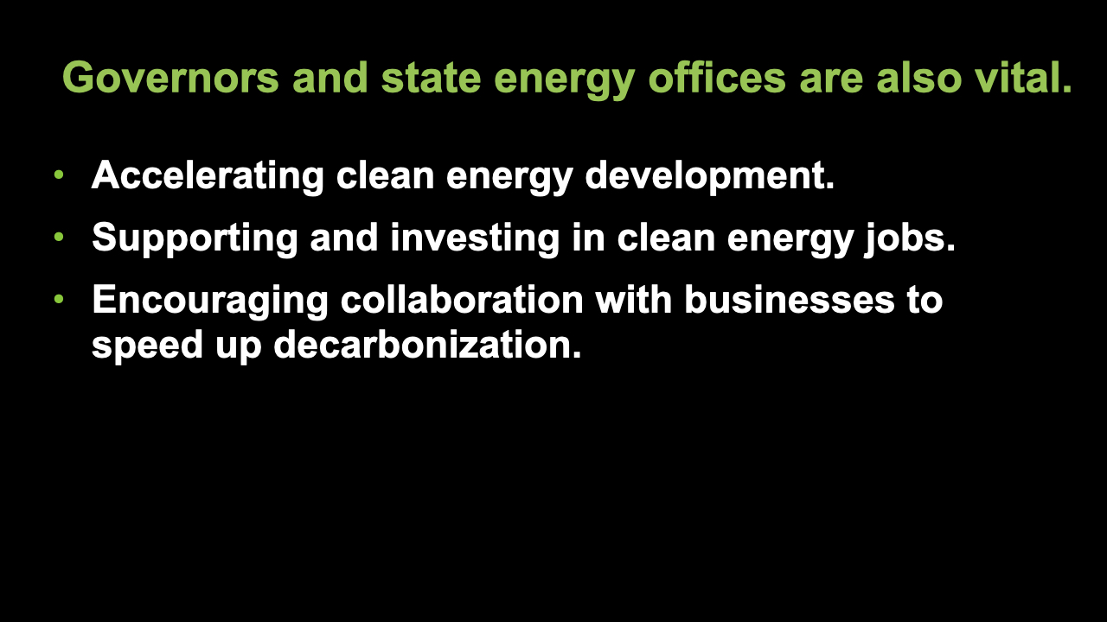
Notes:
ID #7845 - This slide deck may be used in non-commercial presentations that are recorded, broadcast, livestreamed, or presented in-person. You may add your own personal slides to it, but users should make sure they have permission to include any third-party content in their personal slides. You may also remove slides to reduce the length. This slide deck may not be re-published without permission from Climate Reality, used for commercial purposes, or used to support or oppose candidates (or groups of candidates) for elected office. Finally, this slide deck may not be used to claim that The Climate Reality Project endorses any particular legislative action.
Governors and state energy offices can accelerate the development of clean energy. They can support and invest in the creation of new clean energy jobs. They can encourage state agencies and private businesses to collaborate for even faster decarbonization.
DESCRIPTION: Text stating that governors and state energy offices are also vital: accelerating clean energy development; supporting and investing in clean energy jobs; and encouraging collaboration with businesses to speed up decarbonization
SLIDE SOURCE(S): https://energyinnovation.org/wp-content/uploads/2022/11/Inflation-Reduction-Act-Electricity-State-Policy-Roadmap-One-Pager.pdf

Slide 19
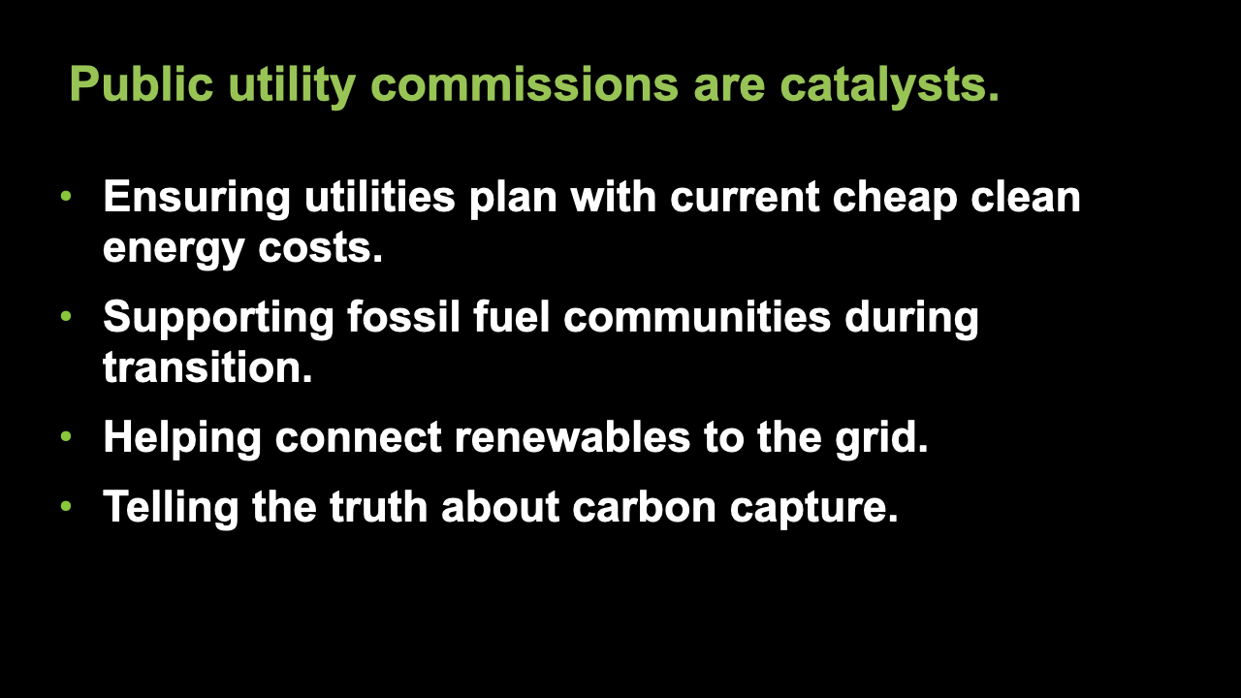
Notes:
ID #7846 - This slide deck may be used in non-commercial presentations that are recorded, broadcast, livestreamed, or presented in-person. You may add your own personal slides to it, but users should make sure they have permission to include any third-party content in their personal slides. You may also remove slides to reduce the length. This slide deck may not be re-published without permission from Climate Reality, used for commercial purposes, or used to support or oppose candidates (or groups of candidates) for elected office. Finally, this slide deck may not be used to claim that The Climate Reality Project endorses any particular legislative action.
Public utility commissioners can ensure that utilities plan adequately and come up with their pricing with the latest and cheaper cost of clean energy, because the IRA makes it even cheaper. It goes down on its own; it'll go down even faster with the IRA. These commissioners can push utilities to support fossil fuel communities as we go through this energy transition. They can streamline the connection of renewables to the grid. That's super important. They can evaluate carbon capture plans honestly, without letting the fossil fuel companies snooker them into believing some of the nonsense that they're putting out there. Let's develop it, let's hope for a breakthrough, but don't let them hoodwink you.
DESCRIPTION: Text stating that public utility commissions are catalysts: ensuring utilities plan with current cheap clean energy costs; supporting fossil fuel communities during transition; helping connect renewables to the grid; and telling the truth about carbon capture
ADDITIONAL TALKING POINTS: Additionally, public utility commissions can enable real competition between expensive fossil fuels and cheaper renewables.
SLIDE SOURCE(S): https://energyinnovation.org/wp-content/uploads/2022/11/Inflation-Reduction-Act-Electricity-State-Policy-Roadmap-One-Pager.pdf

Slide 20
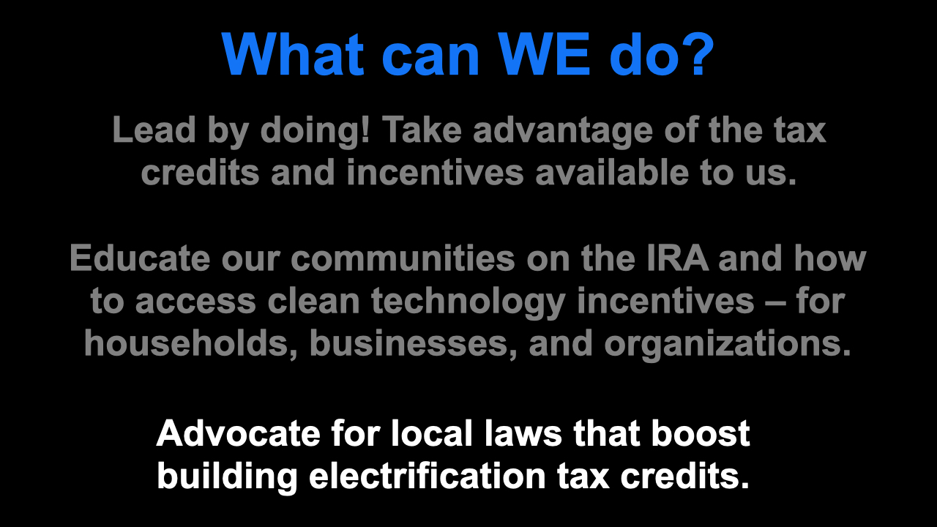
Notes:
ID #7847 - This slide deck may be used in non-commercial presentations that are recorded, broadcast, livestreamed, or presented in-person. You may add your own personal slides to it, but users should make sure they have permission to include any third-party content in their personal slides. You may also remove slides to reduce the length. This slide deck may not be re-published without permission from Climate Reality, used for commercial purposes, or used to support or oppose candidates (or groups of candidates) for elected office. Finally, this slide deck may not be used to claim that The Climate Reality Project endorses any particular legislative action.
So what can we do? Lead by doing! We need to get active and take advantage of the tax credits and incentives that are available to each one of us. We can educate our communities on the IRA and its provisions and how to gain access to the clean technology incentives. That's for households, it's for businesses, and for NGOs and other organizations. We can advocate for new local laws that boost the electrification of buildings to take advantage of the enormous tax credits that are available there.
DESCRIPTION: Text explaining what WE can do: lead by doing — take advantage of the tax credits and incentives available to us; educate our communities on the IRA and how to access clean technology incentives – for households, businesses, and organizations; and advocate for local laws that boost building electrification tax credits

Slide 21
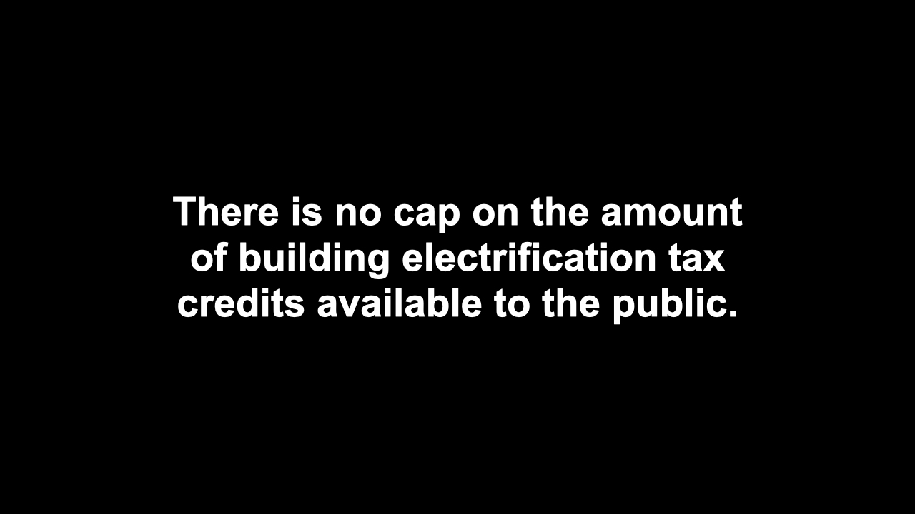
Notes:
ID #7848 - This slide deck may be used in non-commercial presentations that are recorded, broadcast, livestreamed, or presented in-person. You may add your own personal slides to it, but users should make sure they have permission to include any third-party content in their personal slides. You may also remove slides to reduce the length. This slide deck may not be re-published without permission from Climate Reality, used for commercial purposes, or used to support or oppose candidates (or groups of candidates) for elected office. Finally, this slide deck may not be used to claim that The Climate Reality Project endorses any particular legislative action.
As I said before, there's no cap on the amount of the building electrification tax credits available to the public. The sky's the limit, so the more we can apply for and successfully get these, then the more progress we will make.
DESCRIPTION: Text stating that there is no cap on the amount of building electrification tax credits available to the public
ADDITIONAL TALKING POINTS: The more people we bring into the program, the more we decarbonize, and the more people save money on energy costs.
SLIDE SOURCE(S): https://rmi.org/the-inflation-reduction-act-could-transform-the-us-buildings-sector/

Slide 22
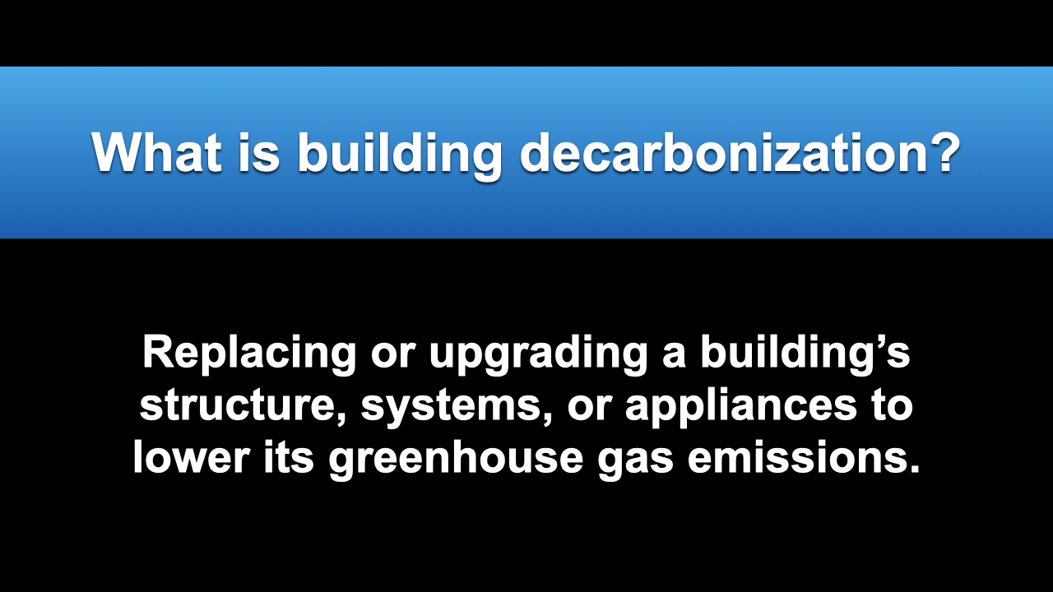
Notes:
ID #7849 - This slide deck may be used in non-commercial presentations that are recorded, broadcast, livestreamed, or presented in-person. You may add your own personal slides to it, but users should make sure they have permission to include any third-party content in their personal slides. You may also remove slides to reduce the length. This slide deck may not be re-published without permission from Climate Reality, used for commercial purposes, or used to support or oppose candidates (or groups of candidates) for elected office. Finally, this slide deck may not be used to claim that The Climate Reality Project endorses any particular legislative action.
What is building decarbonization? I think most people know, but it's the process of replacing or upgrading a building's infrastructure, systems, and appliances in a way that lowers the greenhouse gas emissions.
DESCRIPTION: Text explaining what building decarbonization is: replacing or upgrading a building’s structure, systems, or appliances to lower its greenhouse gas emissions
SLIDE SOURCE(S): https://www.c2es.org/document/decarbonizing-u-s-buildings/

Slide 23
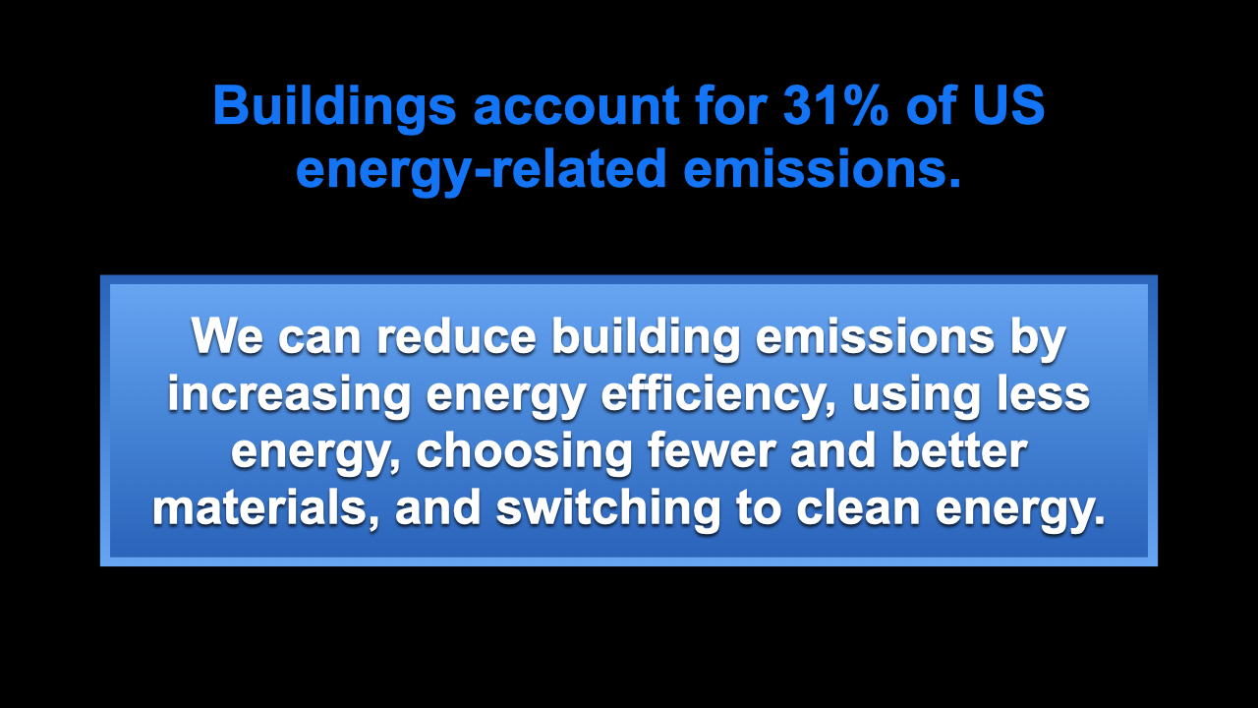
Notes:
ID #7868 - This slide deck may be used in non-commercial presentations that are recorded, broadcast, livestreamed, or presented in-person. You may add your own personal slides to it, but users should make sure they have permission to include any third-party content in their personal slides. You may also remove slides to reduce the length. This slide deck may not be re-published without permission from Climate Reality, used for commercial purposes, or used to support or oppose candidates (or groups of candidates) for elected office. Finally, this slide deck may not be used to claim that The Climate Reality Project endorses any particular legislative action.
Buildings account for more than 30% of the energy-related CO2 emissions in the US. The reductions can come from a mix of things: energy efficiency, lower demand for energy, fewer and better materials, and the generation of clean energy.
DESCRIPTION: Text stating that buildings account for 31% of US energy-related emissions. We can reduce building emissions by increasing energy efficiency, using less energy, choosing fewer and better materials, and switching to clean energy.
ADDITIONAL TALKING POINTS: According to a 2022 report by the Intergovernmental Panel on Climate Change, “The 2020–2030 decade is critical for accelerating the learning of know-how, building the technical and institutional capacity, setting the appropriate governance structures, ensuring the flow of finance, and in developing the skills needed to fully capture the mitigation potential of buildings.”
SLIDE SOURCE(S): https://www.usgbc.org/sites/default/files/2022-05/USGBC-Issue-Brief-1-Building-Decarbonization-2022-5-4.pdf; https://www.ipcc.ch/report/ar6/wg3/downloads/report/IPCC_AR6_WGIII_SPM.pdf

Slide 24
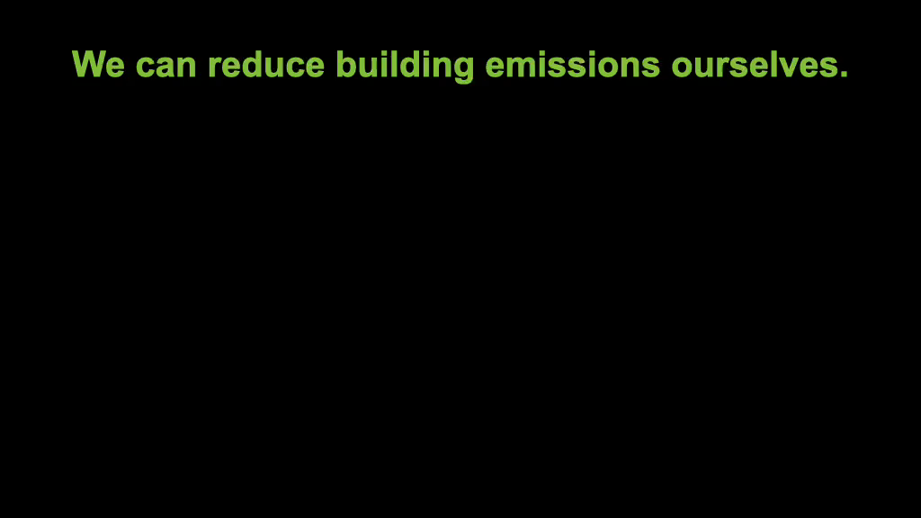
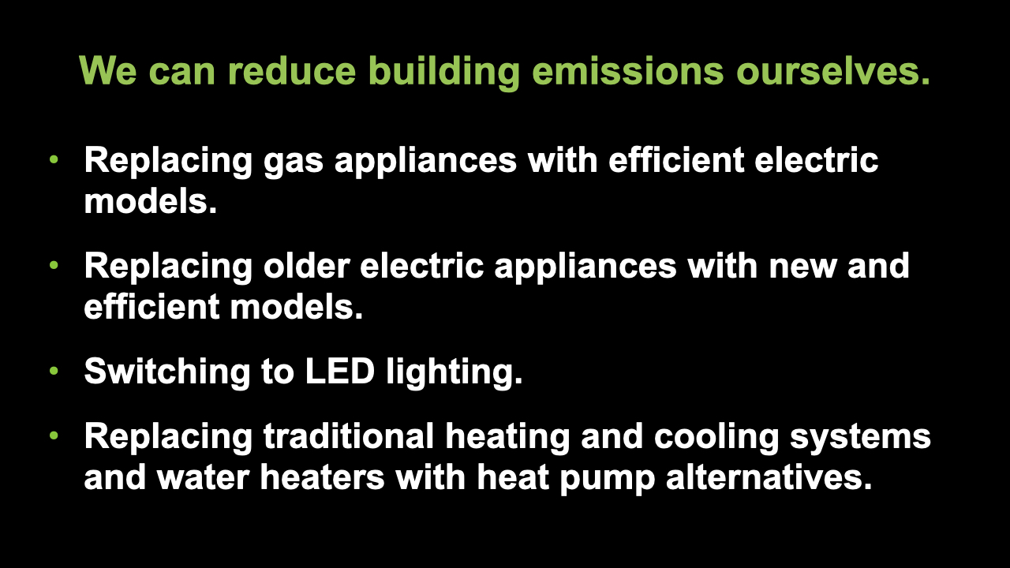
Notes:
ID #7850 - This slide deck may be used in non-commercial presentations that are recorded, broadcast, livestreamed, or presented in-person. You may add your own personal slides to it, but users should make sure they have permission to include any third-party content in their personal slides. You may also remove slides to reduce the length. This slide deck may not be re-published without permission from Climate Reality, used for commercial purposes, or used to support or oppose candidates (or groups of candidates) for elected office. Finally, this slide deck may not be used to claim that The Climate Reality Project endorses any particular legislative action.
There are many ways that individuals can pursue building decarbonization, including the replacement of gas-fueled appliances with more efficient electric alternatives. They can replace older electric appliances with newer, far more efficient models, because they've gotten a lot better in recent years. They can change the lightbulbs. I always say, "It's important to change the lightbulbs, more important to change the laws." But the lightbulbs are important. There are so many new options and different kinds of LEDs. They're cheaper, they last 10 times as long, they use far less electricity. Some people know this already, but for those who don't, let's encourage them to switch as well. They can replace their traditional HVAC systems, heating and air conditioning, with heat pumps, and they can replace their traditional water heaters with heat pump water heaters. This technology doesn't sound like it has a lot of so-called "sex appeal," but they're great, they're so much more efficient, and they save you so much money, and it doesn't matter how cold the climate is where you live. People in Maine, people in Canada, it works fine, doesn't matter how cold it is. Heat pumps are just much better.
DESCRIPTION: Text stating that we can reduce building emissions ourselves by replacing gas appliances with efficient electric models; replacing older electric appliances with new and efficient models; switching to LED lighting; and replacing traditional heating and cooling systems and water heaters with heat pump alternatives
SLIDE SOURCE(S): https://surveys.signforgood.com/rewiring-america-electrify-everything?code=jtk9-ot-fl

Slide 25
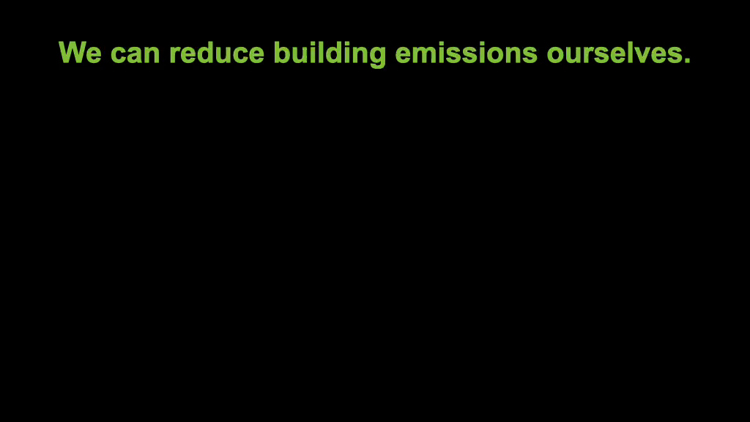
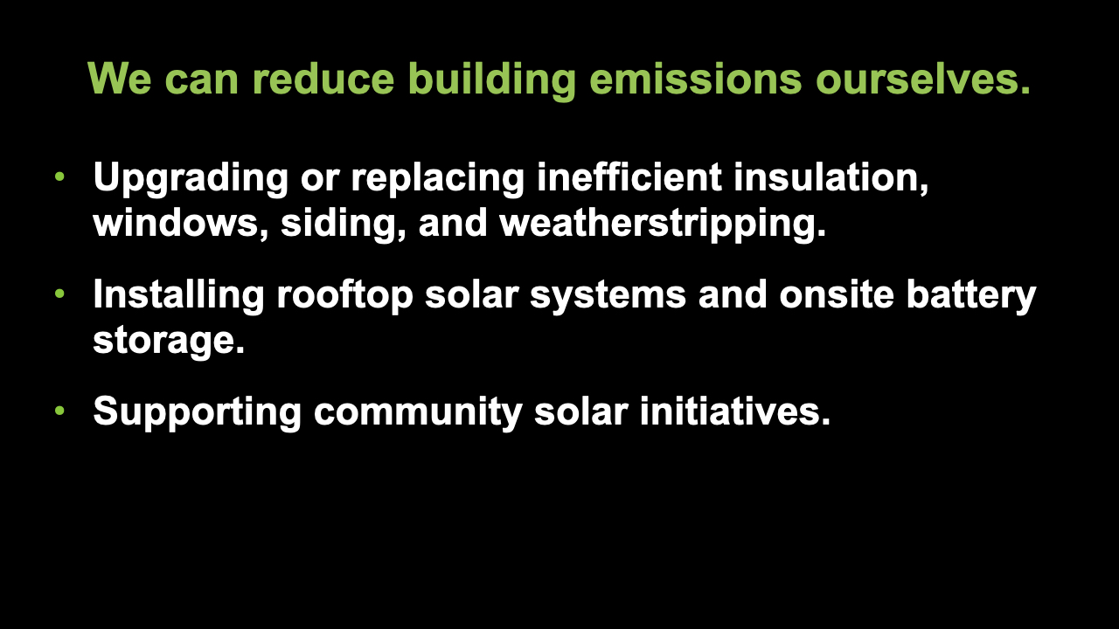
Notes:
ID #7869 - This slide deck may be used in non-commercial presentations that are recorded, broadcast, livestreamed, or presented in-person. You may add your own personal slides to it, but users should make sure they have permission to include any third-party content in their personal slides. You may also remove slides to reduce the length. This slide deck may not be re-published without permission from Climate Reality, used for commercial purposes, or used to support or oppose candidates (or groups of candidates) for elected office. Finally, this slide deck may not be used to claim that The Climate Reality Project endorses any particular legislative action.
It also means, by the way, replacing inefficient insulation, upgrading your insulation, making sure you have the best kinds of windows. Lots of heat goes out of poorly made, poorly designed windows in the winter, and a lot of cooling air goes out in the summer. Keep up with the weatherstripping and siding. There are now benefits available to help you do all of these things, including installing rooftop photovoltaic systems and installing on-site battery storage. Lots of people are doing this, and the provisions of this new law make it much easier for everybody to do it. Also, we can support community solar initiatives where individual solar systems aren't really that viable. Say, if you're living in an apartment, you can't put it on your windowsill, but you can be part of a group using community solar. That's a very fast-growing form of solar energy.
DESCRIPTION: Text stating that we can reduce building emissions ourselves by upgrading or replacing inefficient insulation, windows, siding, and weatherstripping; installing rooftop solar systems and onsite battery storage; and supporting community solar initiatives
SLIDE SOURCE(S): https://surveys.signforgood.com/rewiring-america-electrify-everything?code=jtk9-ot-fl

Slide 26
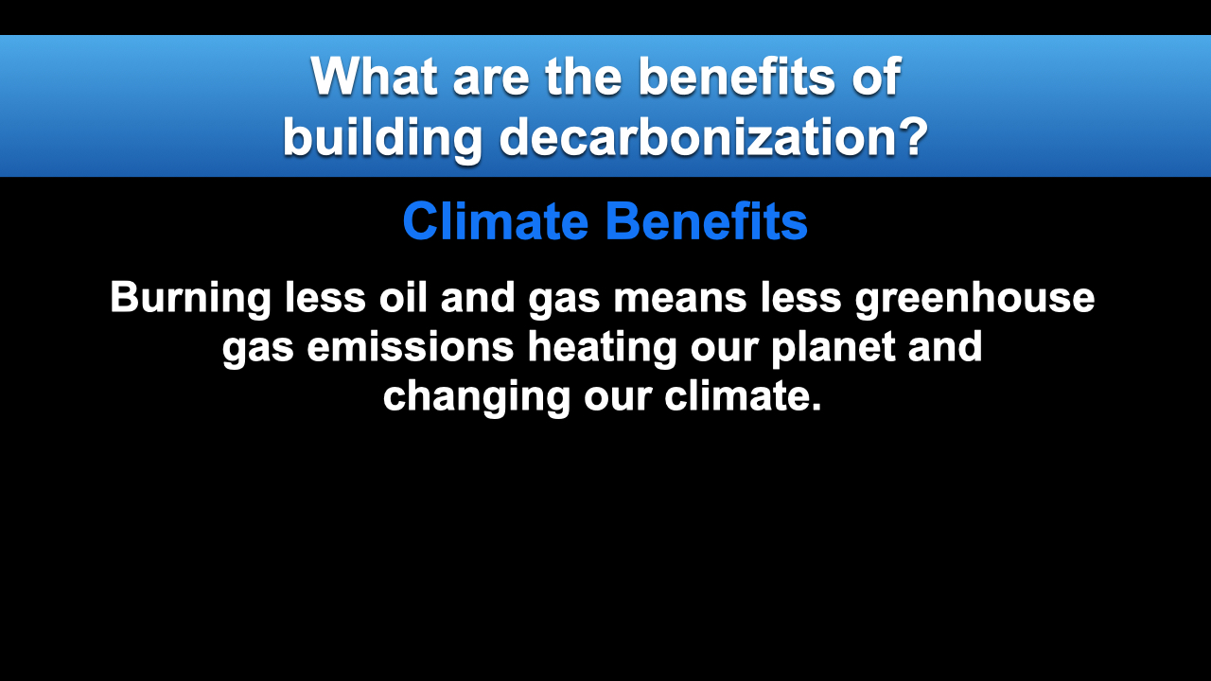
Notes:
ID #7851 - This slide deck may be used in non-commercial presentations that are recorded, broadcast, livestreamed, or presented in-person. You may add your own personal slides to it, but users should make sure they have permission to include any third-party content in their personal slides. You may also remove slides to reduce the length. This slide deck may not be re-published without permission from Climate Reality, used for commercial purposes, or used to support or oppose candidates (or groups of candidates) for elected office. Finally, this slide deck may not be used to claim that The Climate Reality Project endorses any particular legislative action.
So, what are the benefits if we decarbonize buildings? First of all, we reduce a big source of air pollution, we sharply reduce the greenhouse gas emissions, and help solve the climate crisis. Reducing the carbon emissions from buildings through electrification actually helps us mitigate climate change – it's one of the most effective ways to do it.
DESCRIPTION: Text explaining the climate benefits of building decarbonization. Burning less oil and gas means less greenhouse gas emissions heating our planet and changing our climate.
SLIDE SOURCE(S): https://rmi.org/eight-benefits-of-building-electrification-for-households-communities-and-climate/

Slide 27
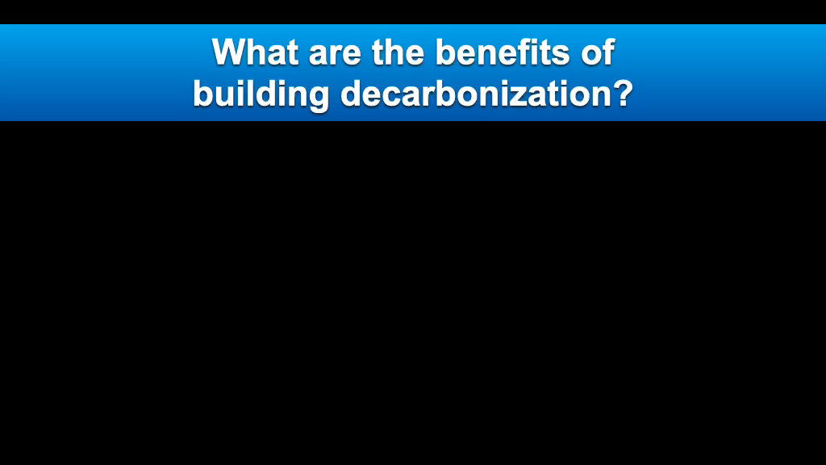
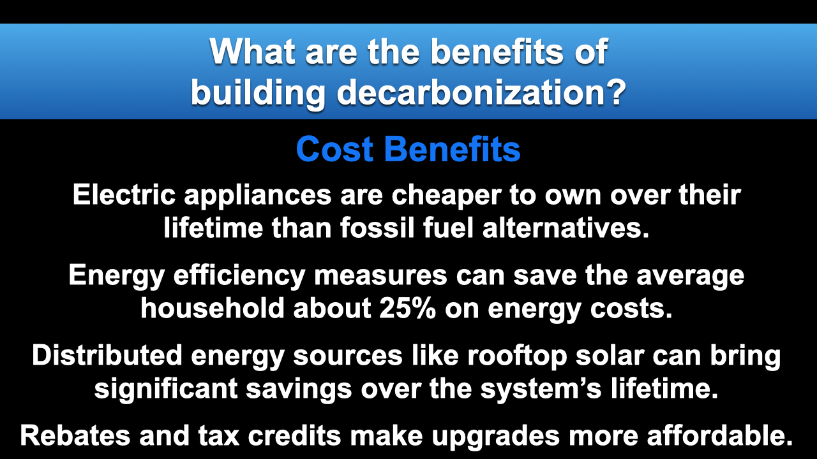
Notes:
ID #7852 - This slide deck may be used in non-commercial presentations that are recorded, broadcast, livestreamed, or presented in-person. You may add your own personal slides to it, but users should make sure they have permission to include any third-party content in their personal slides. You may also remove slides to reduce the length. This slide deck may not be re-published without permission from Climate Reality, used for commercial purposes, or used to support or oppose candidates (or groups of candidates) for elected office. Finally, this slide deck may not be used to claim that The Climate Reality Project endorses any particular legislative action.
And there are cost benefits. The electric appliances have a much lower lifetime cost of operating and cost of ownership than the fossil fuel-based alternatives. It's been proven. The energy efficiency measures can save the average household about 25% on energy costs, and that adds up to real money. Distributed energy sources – that's a phrase that often applies to rooftop solar – can bring significant savings over the life of the system. And the rebates and tax credits in this law make all of these upgrades far more affordable.
DESCRIPTION: Text explaining the cost benefits of building decarbonization. Electric appliances are cheaper to own over their lifetime than fossil fuel alternatives. Energy efficiency measures can save the average household about 25% on energy costs. Distributed energy sources like rooftop solar can bring significant savings over the system’s lifetime. Rebates and tax credits make upgrades more affordable.
SLIDE SOURCE(S): https://rmi.org/insight/the-economics-of-electrifying-buildings/; https://www.energysage.com/energy-efficiency/why-conserve-energy/cost-of-ee/; https://news.energysage.com/much-solar-panels-save/

Slide 28
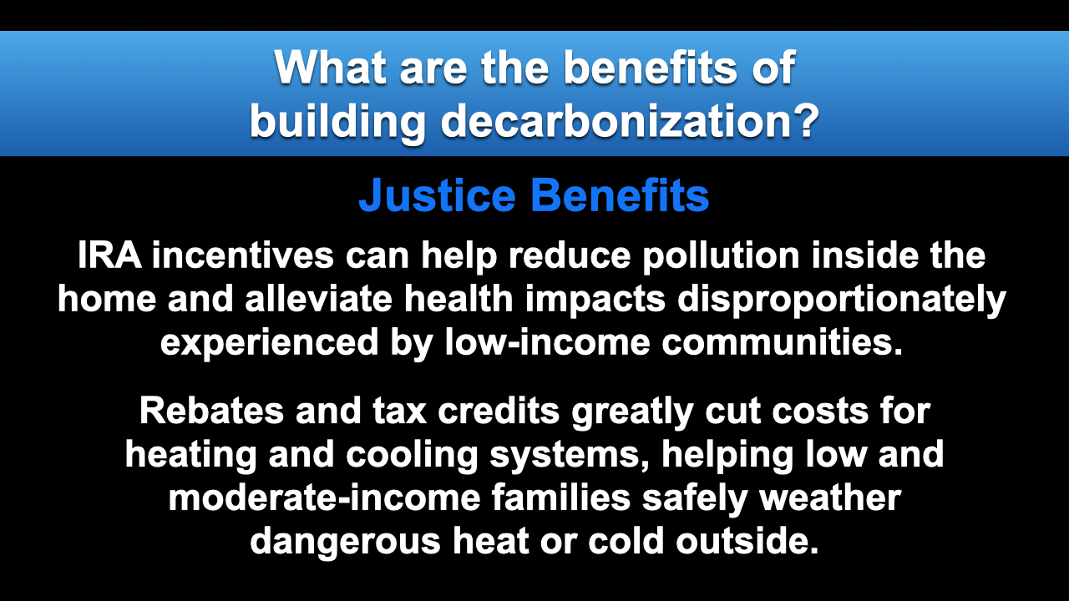
Notes:
ID #7853 - This slide deck may be used in non-commercial presentations that are recorded, broadcast, livestreamed, or presented in-person. You may add your own personal slides to it, but users should make sure they have permission to include any third-party content in their personal slides. You may also remove slides to reduce the length. This slide deck may not be re-published without permission from Climate Reality, used for commercial purposes, or used to support or oppose candidates (or groups of candidates) for elected office. Finally, this slide deck may not be used to claim that The Climate Reality Project endorses any particular legislative action.
There are benefits where environmental justice is concerned, and it's high time that we pay the kind of attention to that horrible challenge and the needed solutions that we see in this law. Home environments have been shown to be extremely important determinants of the health of the people who live in those homes, and low-income communities experience higher rates of asthma, especially among children, and are far more likely to suffer from the health impacts related to pollution and the exposure to extreme heat. These incentives will have maybe the biggest impact in the communities that have been unable, financially, to make these improvements. They're subsidized, and the benefits are tremendous. Available incentives also especially benefit the frontline communities by lowering their exposure to pollution inside the homes and increasing access to clean and affordable heating and cooling technologies.
DESCRIPTION: Text explaining the justice benefits of building decarbonization. IRA incentives can help reduce pollution inside the home and alleviate health impacts disproportionately experienced by low-income communities. Rebates and tax credits greatly cut costs for heating and cooling systems, helping low and moderate-income families safely weather dangerous heat or cold outside.
SLIDE SOURCE(S): https://rmi.org/eight-benefits-of-building-electrification-for-households-communities-and-climate/; https://rmi.org/insight/decarbonizing-homes/; https://www.novoco.com/notes-from-novogradac/inflation-reduction-act-overview-clean-energy-provisions-and-their-impact-affordable-housing

Slide 29


Notes:
ID #7809 - This slide deck may be used in non-commercial presentations that are recorded, broadcast, livestreamed, or presented in-person. You may add your own personal slides to it, but users should make sure they have permission to include any third-party content in their personal slides. You may also remove slides to reduce the length. This slide deck may not be re-published without permission from Climate Reality, used for commercial purposes, or used to support or oppose candidates (or groups of candidates) for elected office. Finally, this slide deck may not be used to claim that The Climate Reality Project endorses any particular legislative action.
You've heard a lot about gas stoves recently. I didn't realize until I looked at all the research, and we've seen some of it in the news media, one out of every eight cases of childhood asthma is linked to gas stove pollution, which leaks the methane into the room. I didn't know it, but it's a serious problem.
DESCRIPTION: Photo of an adult holding a baby while cooking on a gas stove, with text stating that about one-in-eight cases of childhood asthma in the US are caused by gas stove pollution
SLIDE SOURCE(S): https://www.mdpi.com/1660-4601/20/1/75

Slide 30

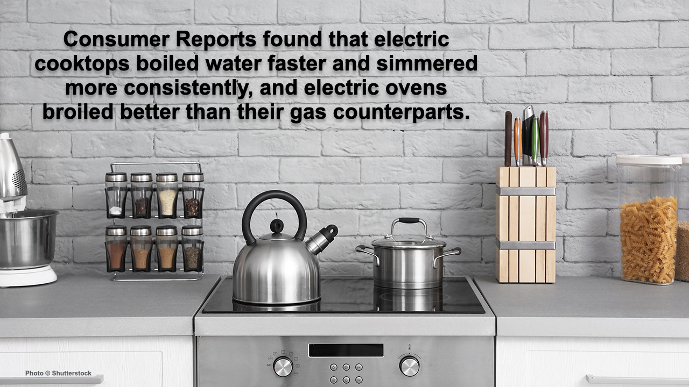
Notes:
ID #7854 - This slide deck may be used in non-commercial presentations that are recorded, broadcast, livestreamed, or presented in-person. You may add your own personal slides to it, but users should make sure they have permission to include any third-party content in their personal slides. You may also remove slides to reduce the length. This slide deck may not be re-published without permission from Climate Reality, used for commercial purposes, or used to support or oppose candidates (or groups of candidates) for elected office. Finally, this slide deck may not be used to claim that The Climate Reality Project endorses any particular legislative action.
A Consumer Reports study found that the electric stovetops are far better. They boil water faster; they simmer more consistently. The finest chefs say, Oh, yeah, that's the best option for sure. And for cost, it's the best option. And they broil better than their gas counterparts.
DESCRIPTION: Photo of an electric cooktop, with text stating that Consumer Reports found that electric cooktops boiled water faster and simmered more consistently, and electric ovens broiled better than their gas counterparts
SLIDE SOURCE(S): https://www.consumerreports.org/ranges/gas-or-electric-range-which-is-better-a1142956590/

Slide 31
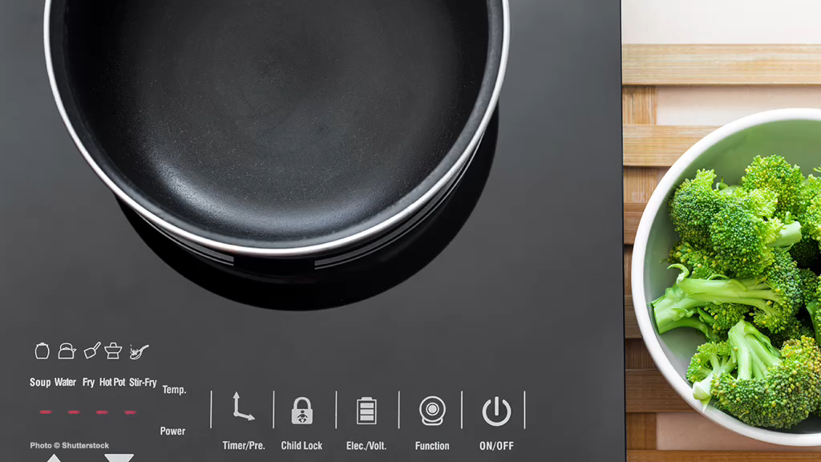
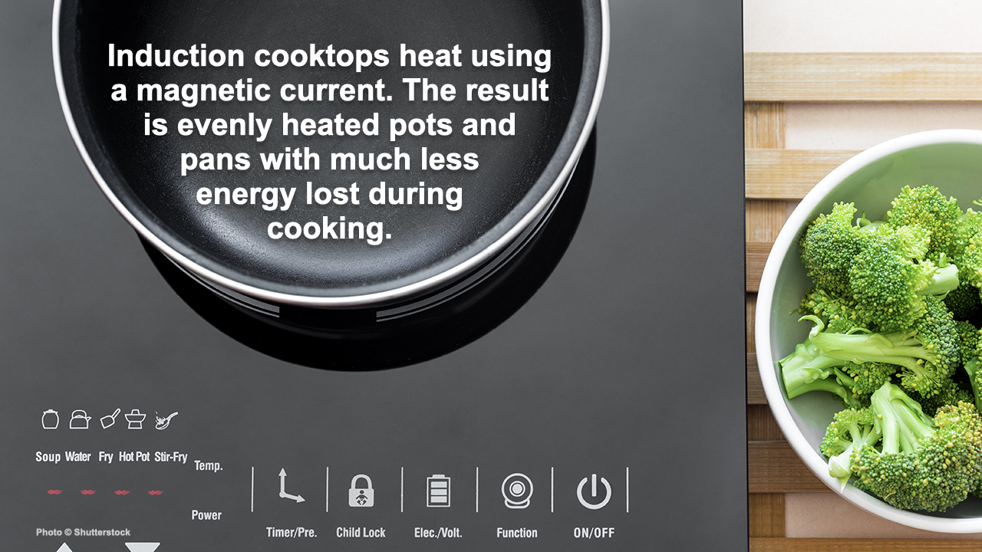
Notes:
ID #7870 - This slide deck may be used in non-commercial presentations that are recorded, broadcast, livestreamed, or presented in-person. You may add your own personal slides to it, but users should make sure they have permission to include any third-party content in their personal slides. You may also remove slides to reduce the length. This slide deck may not be re-published without permission from Climate Reality, used for commercial purposes, or used to support or oppose candidates (or groups of candidates) for elected office. Finally, this slide deck may not be used to claim that The Climate Reality Project endorses any particular legislative action.
Induction cooktops use heat in an unusual way. They use a magnetic current that is evenly distributed through the cooking pan. The experts have been recommending it for a long time. Now with these incentives, it's time to make that switch.
DESCRIPTION: Photo of an induction cooktop next to a bowl of broccoli, with text stating that induction cooktops heat using a magnetic current, and the result is evenly heated pots and pans with much less energy lost during cooking
SLIDE SOURCE(S): https://www.cnet.com/home/kitchen-and-household/induction-vs-electric-cooktops-which-is-right-for-you-in-2021/

Slide 32
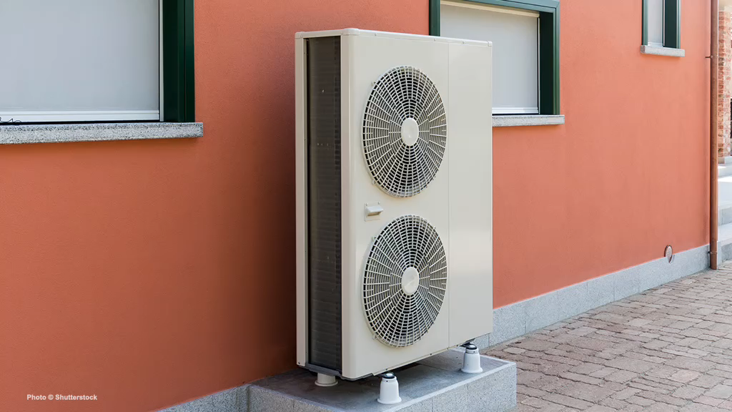
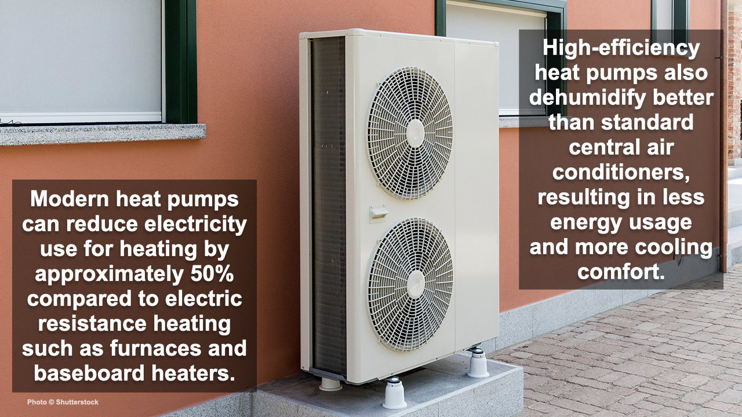
Notes:
ID #7871 - This slide deck may be used in non-commercial presentations that are recorded, broadcast, livestreamed, or presented in-person. You may add your own personal slides to it, but users should make sure they have permission to include any third-party content in their personal slides. You may also remove slides to reduce the length. This slide deck may not be re-published without permission from Climate Reality, used for commercial purposes, or used to support or oppose candidates (or groups of candidates) for elected office. Finally, this slide deck may not be used to claim that The Climate Reality Project endorses any particular legislative action.
I told you we'd talk about heat pumps. Here's an example of one. These modern heat pumps are incredibly efficient. They reduce electricity use for heating by half compared to electric resistance heating like furnaces and baseboard heaters. And the high-efficiency heat pumps dehumidify much better than the standard central air conditioning units, and that results in less energy use and more cooling comfort.
DESCRIPTION: Photo of a heat pump outside an orange building, with text stating that modern heat pumps can reduce electricity use for heating by approximately 50% compared to electric resistance heating such as furnaces and baseboard heaters. High-efficiency heat pumps also dehumidify better than standard central air conditioners, resulting in less energy usage and more cooling comfort.
SLIDE SOURCE(S): https://www.energy.gov/energysaver/heat-pump-systems

Slide 33
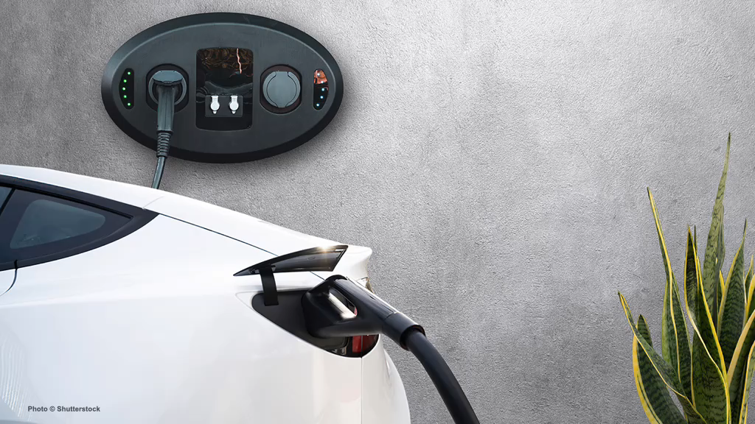
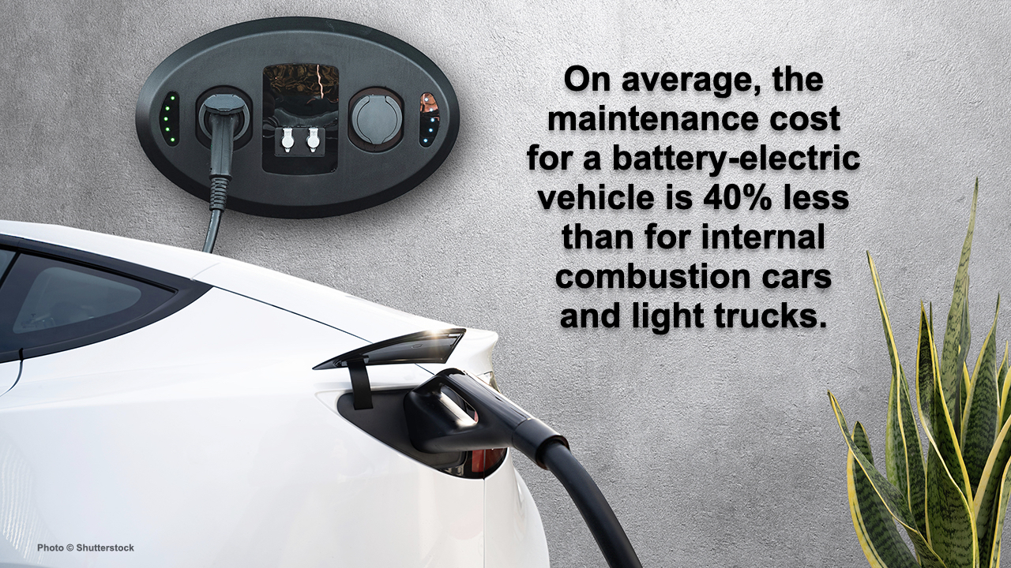
Notes:
ID #7872 - This slide deck may be used in non-commercial presentations that are recorded, broadcast, livestreamed, or presented in-person. You may add your own personal slides to it, but users should make sure they have permission to include any third-party content in their personal slides. You may also remove slides to reduce the length. This slide deck may not be re-published without permission from Climate Reality, used for commercial purposes, or used to support or oppose candidates (or groups of candidates) for elected office. Finally, this slide deck may not be used to claim that The Climate Reality Project endorses any particular legislative action.
When it comes to electric vehicles (EVs), you see the same improvements. On average, the maintenance cost for a battery-electric vehicle is 40% less than the maintenance cost for internal combustion engines and, of course, the cost of operation is much, much lower.
DESCRIPTION: Photo of a white EV plugged into a wall charger, with text stating that on average, the maintenance cost for a battery-electric vehicle is 40% less than for internal combustion cars and light trucks
SLIDE SOURCE(S): https://cleantechnica.com/2021/06/22/its-official-us-government-says-electric-vehicles-cost-40-less-to-maintain/

Slide 34
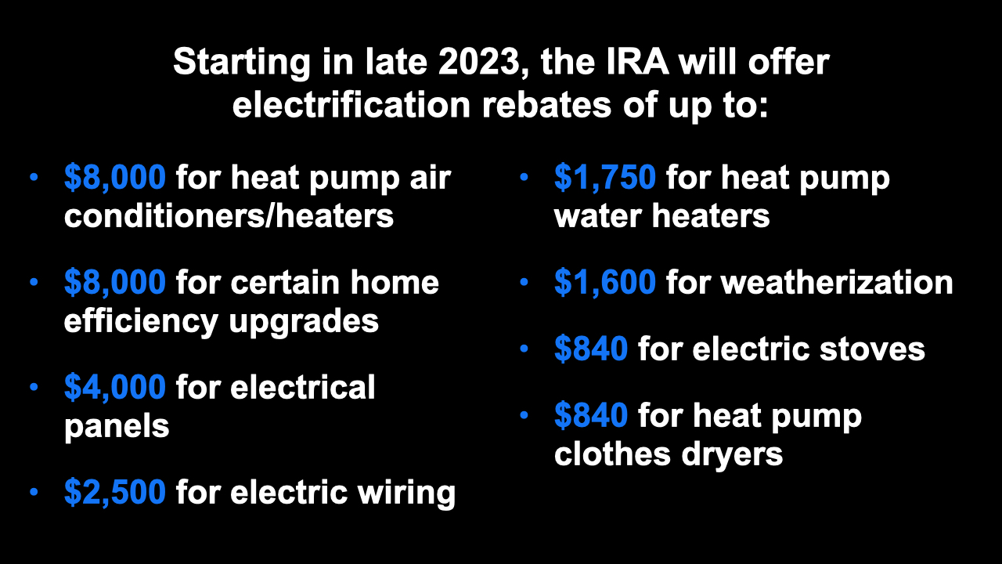
Notes:
ID #7855 - This slide deck may be used in non-commercial presentations that are recorded, broadcast, livestreamed, or presented in-person. You may add your own personal slides to it, but users should make sure they have permission to include any third-party content in their personal slides. You may also remove slides to reduce the length. This slide deck may not be re-published without permission from Climate Reality, used for commercial purposes, or used to support or oppose candidates (or groups of candidates) for elected office. Finally, this slide deck may not be used to claim that The Climate Reality Project endorses any particular legislative action.
Starting late this year, the IRA is going to offer rebates for electrification of up to $8,000 for heat pumps. So that makes it possible for virtually everybody to get. Another $8,000 for some home efficiency upgrades. These are really super important. $4,000 for electrical panels, and also $2,500 for electric wiring. So this is really helpful. And the heat pump water heaters that are so much more efficient, $1,750 per individual in the form of a rebate if you want to switch there, which you should. $1,600 for weatherization, which we were just talking about. $840 to help purchase the induction electric stoves, and $840 for heat pump clothes dryers also, another big efficiency gain.
DESCRIPTION: Text stating that starting in late 2023, the IRA will offer electrification rebates of up to: $8,000 for heat pump air conditioners/heaters; $8,000 for certain home efficiency upgrades; $4,000 for electrical panels; $2,500 for electric wiring; $1,750 for heat pump water heaters; $1,600 for weatherization; $840 for electric stoves; and $840 for heat pump clothes dryers
SLIDE SOURCE(S): https://www.rewiringamerica.org/app/ira-calculator

Slide 35
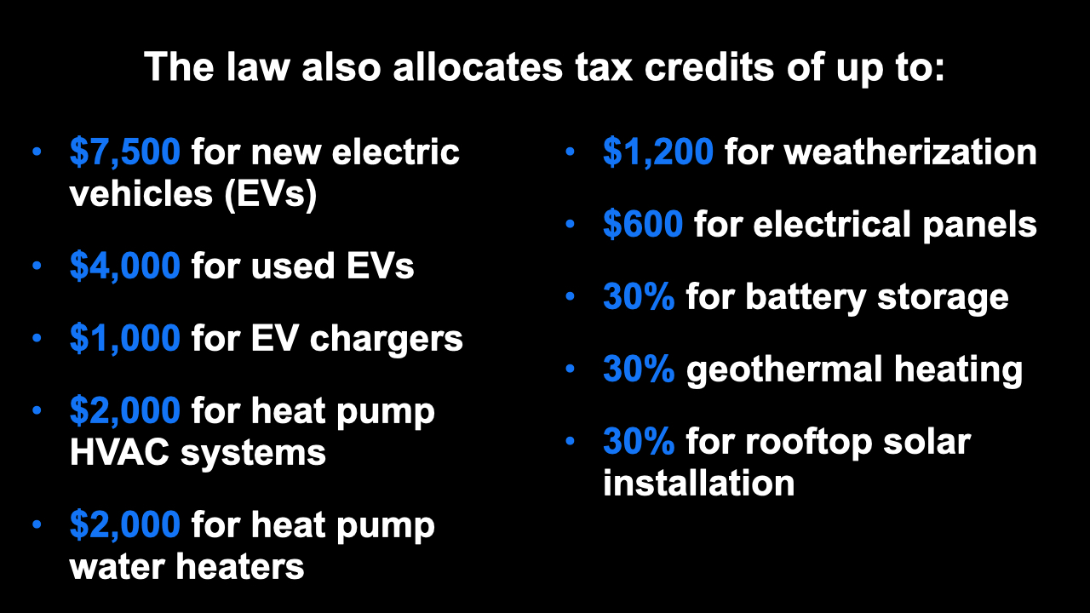
Notes:
ID #7856 - This slide deck may be used in non-commercial presentations that are recorded, broadcast, livestreamed, or presented in-person. You may add your own personal slides to it, but users should make sure they have permission to include any third-party content in their personal slides. You may also remove slides to reduce the length. This slide deck may not be re-published without permission from Climate Reality, used for commercial purposes, or used to support or oppose candidates (or groups of candidates) for elected office. Finally, this slide deck may not be used to claim that The Climate Reality Project endorses any particular legislative action.
The law also allocates tax credits of up to $7,500 for new EVs, and $4,000 for used EVs. That was an interesting debate when it took place, and the advocates made it clear this is really going to help low-income people who want to buy EVs and can't afford a new one. $1,000 for EV chargers you can put in your garage or wherever. And of course, they're also expanding in other provisions of the law, the public network of charging. $2,000 for heat pump HVAC systems. Another $2,000 for heat pump water heaters. These are all tax credits. $1,200 for weatherization. And again, money for the electrical panels, $600. And 30% for battery storage. 30% for geothermal heating – I use that. Not everybody does. I think everybody should, for new construction particularly. 30% for rooftop solar installation.
DESCRIPTION: Text stating that the law also allocates tax credits of up to: $7,500 for new electric vehicles (EVs); $4,000 for used EVs; $1,000 for EV chargers; $2,000 for heat pump HVAC systems; $2,000 for heat pump water heaters; $1,200 for weatherization; $600 for electrical panels; 30% for battery storage; 30% for geothermal heating; and 30% for rooftop solar installation
SLIDE SOURCE(S): https://www.rewiringamerica.org/app/ira-calculator

Slide 36

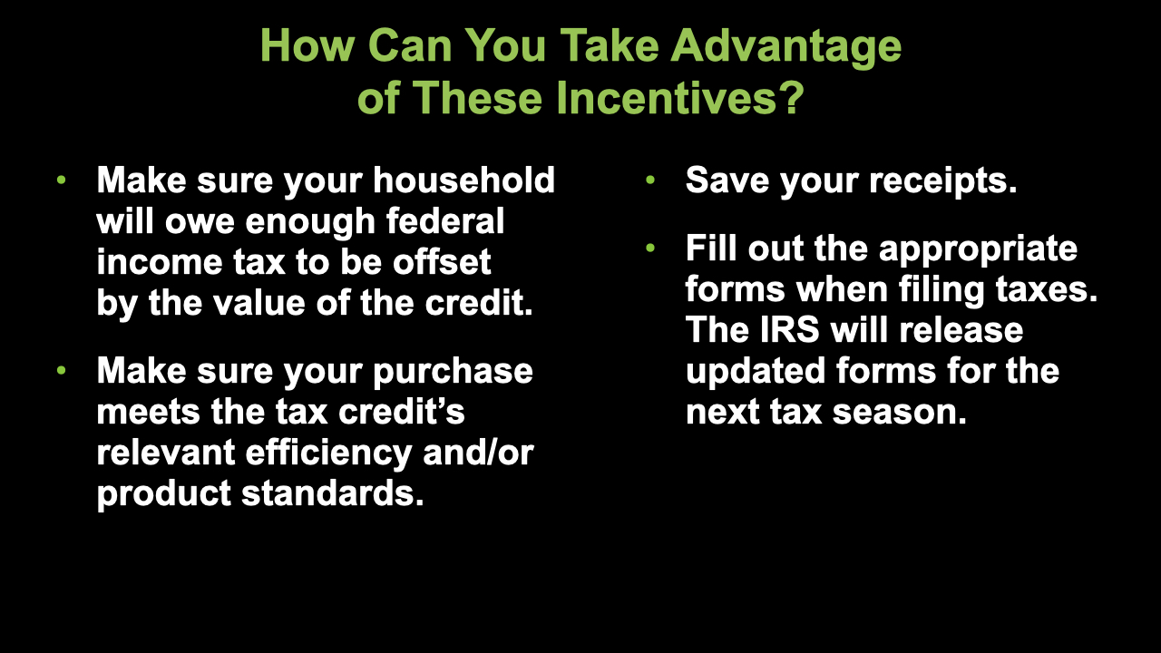
Notes:
ID #7873 - This slide deck may be used in non-commercial presentations that are recorded, broadcast, livestreamed, or presented in-person. You may add your own personal slides to it, but users should make sure they have permission to include any third-party content in their personal slides. You may also remove slides to reduce the length. This slide deck may not be re-published without permission from Climate Reality, used for commercial purposes, or used to support or oppose candidates (or groups of candidates) for elected office. Finally, this slide deck may not be used to claim that The Climate Reality Project endorses any particular legislative action.
So how can you take advantage of these incredible incentives? First of all, make sure that you are going to owe enough federal tax to get the benefit of it, to be offset by the value of the credit – not everybody is in that category. There are other provisions for those who are not. Next, make sure that your purchase meets the provisions of the tax credit that are relevant for the efficiency or product standards. Then save your receipts – you may need them. Fill out the appropriate forms when you file your taxes, and the IRS is imminently going to release updated forms for the next tax season.
DESCRIPTION: Text explaining how you can take advantage of these incentives: make sure your household will owe enough federal income tax to be offset by the value of the credit; make sure your purchase meets the tax credit’s relevant efficiency and/or product standards; save your receipts; and fill out the appropriate forms when filing taxes — the IRS will release updated forms for the next tax season

Slide 37
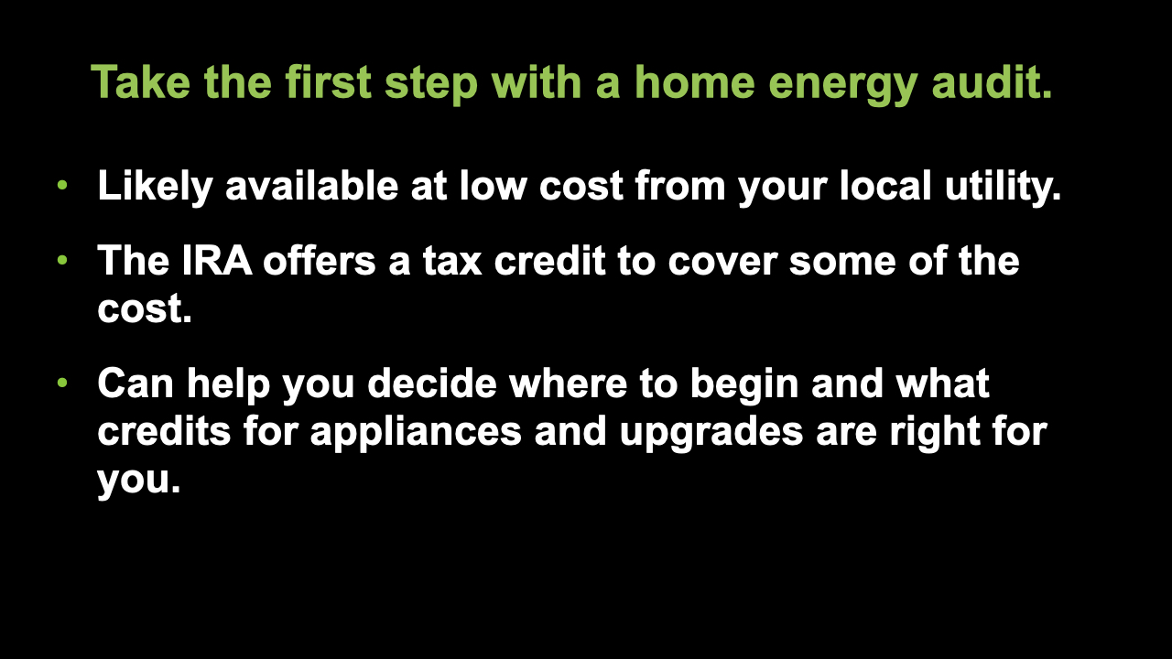
Notes:
ID #7874 - This slide deck may be used in non-commercial presentations that are recorded, broadcast, livestreamed, or presented in-person. You may add your own personal slides to it, but users should make sure they have permission to include any third-party content in their personal slides. You may also remove slides to reduce the length. This slide deck may not be re-published without permission from Climate Reality, used for commercial purposes, or used to support or oppose candidates (or groups of candidates) for elected office. Finally, this slide deck may not be used to claim that The Climate Reality Project endorses any particular legislative action.
A home energy audit is the first step on your journey toward electrification of your home. Your local electric utility likely offers this service at a very low price, and the IRA offers a tax credit to cover some of the cost of a home energy audit. It's worth getting. An audit can help you decide where to begin investing in the electrification of your home and in choosing the tax credits for efficient appliances and weatherization upgrades that are best for you.
DESCRIPTION: Text stating: take the first step with a home energy audit. Likely available at low cost from your local utility; the IRA offers a tax credit to cover some of the cost; and can help you decide where to begin and what credits for appliances and upgrades are right for you.
ADDITIONAL TALKING POINTS: A home energy audit will help you identify where your house may be leaking heat or otherwise consuming unnecessary energy.
SLIDE SOURCE(S): https://www.energy.gov/energysaver/professional-home-energy-assessments; https://www.nrdc.org/stories/consumer-guide-inflation-reduction-act; https://www.rewiringamerica.org/app/ira-calculator/information/weatherization

Slide 38
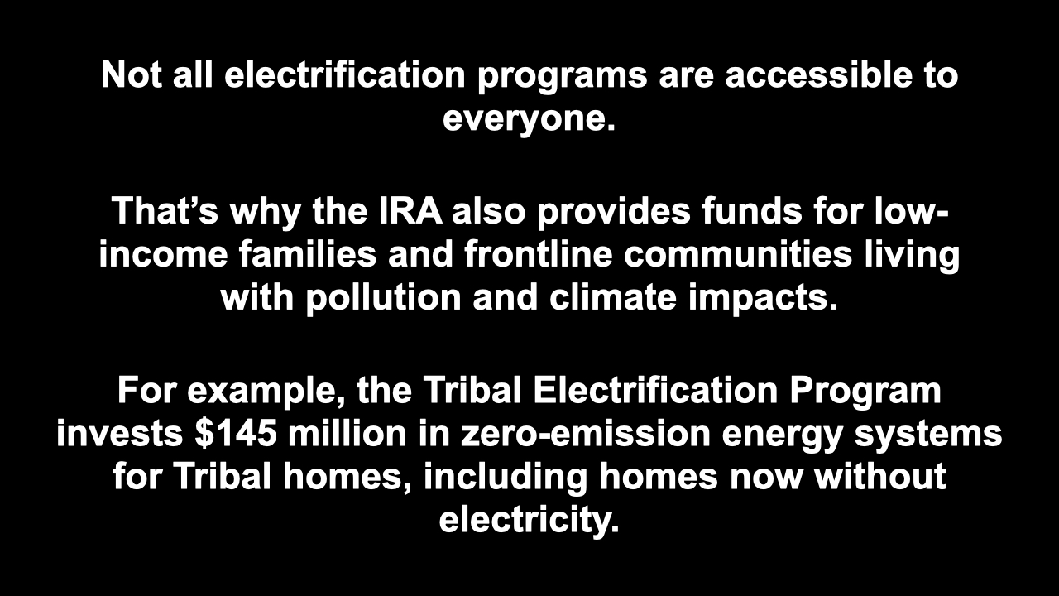
Notes:
ID #7875 - This slide deck may be used in non-commercial presentations that are recorded, broadcast, livestreamed, or presented in-person. You may add your own personal slides to it, but users should make sure they have permission to include any third-party content in their personal slides. You may also remove slides to reduce the length. This slide deck may not be re-published without permission from Climate Reality, used for commercial purposes, or used to support or oppose candidates (or groups of candidates) for elected office. Finally, this slide deck may not be used to claim that The Climate Reality Project endorses any particular legislative action.
Despite the historic investment in clean energy by this historic law, the IRA, these electrification programs actually may not be accessible for absolutely everyone yet. The law does provide funds to low-income and frontline communities for sure, those that have borne the brunt of environmental injustice and the effects of climate change. A good example is the $145 million Tribal Electrification Program to provide electricity to un-electrified tribal homes through zero-emission energy systems, and to transition electrified homes to zero-emission energy systems.
DESCRIPTION: Text stating that not all electrification programs are accessible to everyone. That’s why the IRA also provides funds for low-income families and frontline communities living with pollution and climate impacts. For example, the Tribal Electrification Program invests $145 million in zero-emission energy systems for Tribal homes, including homes now without electricity.
SLIDE SOURCE(S): https://www.rewiringamerica.org/app/ira-calculator; https://www.hklaw.com/en/insights/publications/2022/12/tribal-provisions-in-the-inflation-reduction-act-address-energy

Slide 39
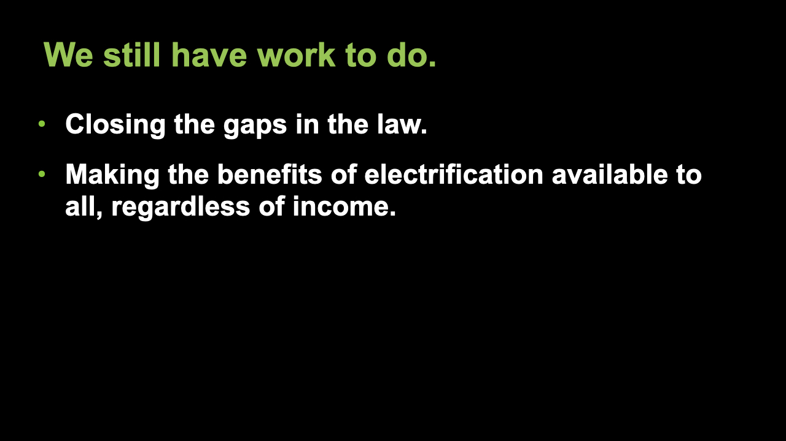
Notes:
ID #7876 - This slide deck may be used in non-commercial presentations that are recorded, broadcast, livestreamed, or presented in-person. You may add your own personal slides to it, but users should make sure they have permission to include any third-party content in their personal slides. You may also remove slides to reduce the length. This slide deck may not be re-published without permission from Climate Reality, used for commercial purposes, or used to support or oppose candidates (or groups of candidates) for elected office. Finally, this slide deck may not be used to claim that The Climate Reality Project endorses any particular legislative action.
So, there is still work to do. In spite of all this progress – and we ought to celebrate it – there is still work to do to close the gaps in the law and ensure that everyone will be able to afford the transition to clean, electrified homes, lower energy costs, and cleaner air.
DESCRIPTION: Text stating that we still have work to do: closing the gaps in the law and making the benefits of electrification available to all, regardless of income

Slide 40
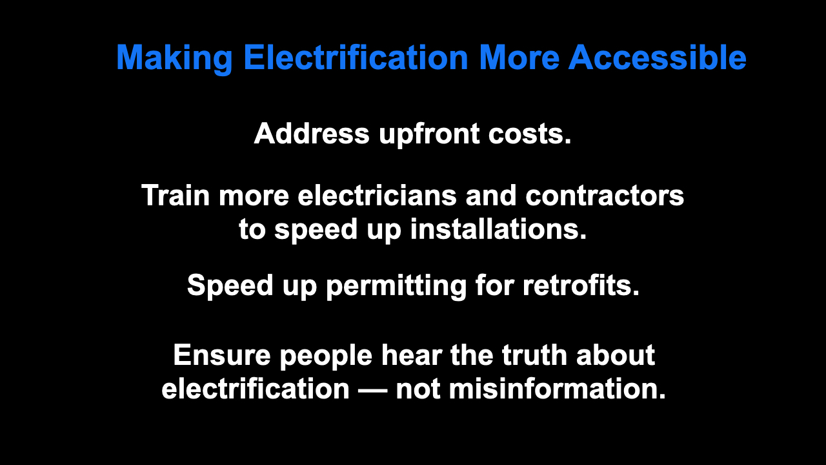
Notes:
ID #7877 - This slide deck may be used in non-commercial presentations that are recorded, broadcast, livestreamed, or presented in-person. You may add your own personal slides to it, but users should make sure they have permission to include any third-party content in their personal slides. You may also remove slides to reduce the length. This slide deck may not be re-published without permission from Climate Reality, used for commercial purposes, or used to support or oppose candidates (or groups of candidates) for elected office. Finally, this slide deck may not be used to claim that The Climate Reality Project endorses any particular legislative action.
The opportunities to make electrification accessible to more people are legion. First of all, we ought to make electrification affordable for more families by addressing the upfront costs, and we ought to make the electrification process quicker and easier for families by training more electricians and contractors and by speeding up permitting for retrofits. We need to give people the information they need to make the right decisions through combatting the fossil fuel industry's continuing misinformation campaigns.
DESCRIPTION: Text listing opportunities to make electrification more accessible: address upfront costs; train more electricians and contractors to speed up installations; speed up permitting for retrofits; and ensure people hear the truth about electrification — not misinformation
SLIDE SOURCE(S): https://www.aceee.org/sites/default/files/pdfs/u2204.pdf; https://newbuildings.org/news/a-game-changing-model-code-for-existing-buildings-gives-jurisdictions-a-path-to-eliminate-carbon-emissions-in-the-current-building-stock/; https://www.cnn.com/2023/01/11/business/gas-stoves-trumka/index.html

Slide 41

Notes:
ID #7878 - This slide deck may be used in non-commercial presentations that are recorded, broadcast, livestreamed, or presented in-person. You may add your own personal slides to it, but users should make sure they have permission to include any third-party content in their personal slides. You may also remove slides to reduce the length. This slide deck may not be re-published without permission from Climate Reality, used for commercial purposes, or used to support or oppose candidates (or groups of candidates) for elected office. Finally, this slide deck may not be used to claim that The Climate Reality Project endorses any particular legislative action.
We can address many of these opportunities through policy.
DESCRIPTION: Text stating that we can address many of these opportunities through policy

Slide 42

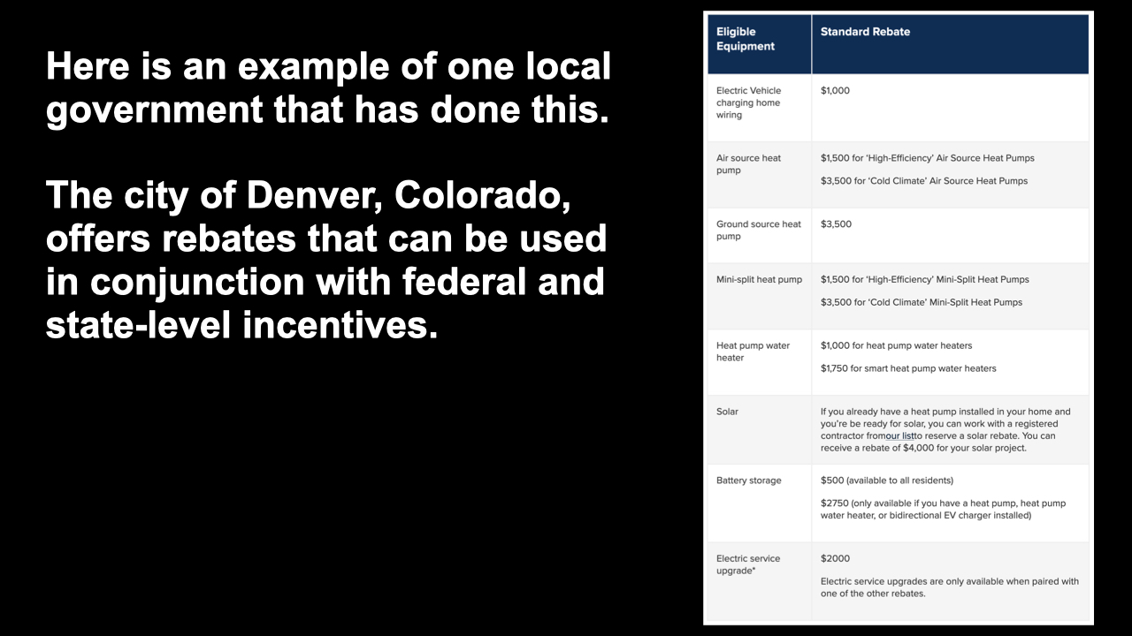
Notes:
ID #7879 - This slide deck may be used in non-commercial presentations that are recorded, broadcast, livestreamed, or presented in-person. You may add your own personal slides to it, but users should make sure they have permission to include any third-party content in their personal slides. You may also remove slides to reduce the length. This slide deck may not be re-published without permission from Climate Reality, used for commercial purposes, or used to support or oppose candidates (or groups of candidates) for elected office. Finally, this slide deck may not be used to claim that The Climate Reality Project endorses any particular legislative action.
Here's an example of a local government that did this. I know you can't read all this easily, but this is from the city of Denver, and this page has a listing of all of the rebates that the city of Denver is offering that can be used in conjunction with the federal incentives and any state-level incentives. So, in the case of Denver, you can add the federal and state of Colorado incentives, where there are some of these, to the city incentives, and the total reduction in your cost can be incredible. So check that out – your city may have a similar program.
DESCRIPTION: Screenshot of a table listing types of eligible equipment and the standard rebate for each one, with text stating that that is an example of one local government that has done this. The city of Denver, Colorado offers rebates that can be used in conjunction with federal and state-level incentives.
ADDITIONAL TALKING POINTS: As you can see, these programs look a lot like what is offered in the IRA. This makes electrifying your home or buying an electric car even more attractive because the incentives “stack.”
SLIDE SOURCE(S): https://www.denvergov.org/Government/Agencies-Departments-Offices/Agencies-Departments-Offices-Directory/Climate-Action-Sustainability-Resiliency/High-Performance-Buildings-and-Homes/Electrify-Your-Home/Space-Heating-and-Cooling/Home-Energy-Rebates

Slide 43
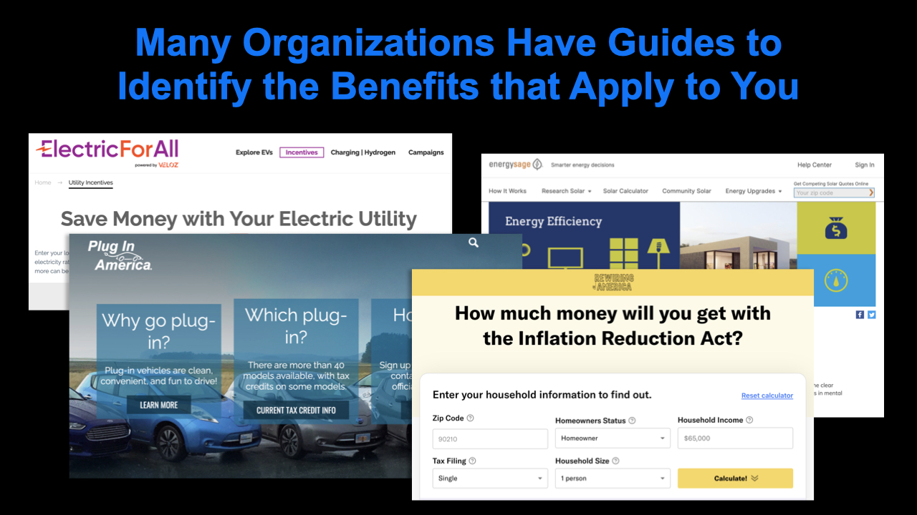
Notes:
ID #7880 - This slide deck may be used in non-commercial presentations that are recorded, broadcast, livestreamed, or presented in-person. You may add your own personal slides to it, but users should make sure they have permission to include any third-party content in their personal slides. You may also remove slides to reduce the length. This slide deck may not be re-published without permission from Climate Reality, used for commercial purposes, or used to support or oppose candidates (or groups of candidates) for elected office. Finally, this slide deck may not be used to claim that The Climate Reality Project endorses any particular legislative action.
There are also a lot of guides available from organizations that really identify the specific benefits that apply to you, no matter which city or state that you live in.
DESCRIPTION: Screenshots of guides to the IRA from Electric For All, EnergySage, Plug In America, and Rewiring America, with text stating that many organizations have guides to identify the benefits that apply to you
SLIDE SOURCE(S): https://www.electricforall.org/electric-utility/; https://www.energysage.com/energy-efficiency/; https://pluginamerica.org; https://www.rewiringamerica.org/app/ira-calculator

Slide 44

Notes:
ID #7863 - This slide deck may be used in non-commercial presentations that are recorded, broadcast, livestreamed, or presented in-person. You may add your own personal slides to it, but users should make sure they have permission to include any third-party content in their personal slides. You may also remove slides to reduce the length. This slide deck may not be re-published without permission from Climate Reality, used for commercial purposes, or used to support or oppose candidates (or groups of candidates) for elected office. Finally, this slide deck may not be used to claim that The Climate Reality Project endorses any particular legislative action.
Please share this presentation with your friends and your family and your wider network. Go to ClimateRealityProject.org/ActsToAction to join the campaign and make this Our Climate Moment.
DESCRIPTION: Our Climate Moment: From Acts to Action logo, with the URL climaterealityproject.org/actstoaction and a QR code
ADDITIONAL TALKING POINTS: We hope that this information helps you start your home’s electrification journey, and that you to take advantage of these programs to benefit your home, but also to help us reduce carbon emissions and avoid the worst effects of climate change. We will train you to give this very presentation and provide you with up-to-date information on these programs to share with your community.

Slide 45

Notes:
ID #7864 - This slide deck may be used in non-commercial presentations that are recorded, broadcast, livestreamed, or presented in-person. You may add your own personal slides to it, but users should make sure they have permission to include any third-party content in their personal slides. You may also remove slides to reduce the length. This slide deck may not be re-published without permission from Climate Reality, used for commercial purposes, or used to support or oppose candidates (or groups of candidates) for elected office. Finally, this slide deck may not be used to claim that The Climate Reality Project endorses any particular legislative action.
Thank you.
DESCRIPTION: The Climate Reality Project logo

